Slide 1
Information in Action
Fanny Widadie, S.P., M.Agr

Slide 2
Information as a Critical Success Factor
Critical success factor (CSF) was coined by Ronald Daniel to identify a few key activities that spell success or failure for any type of organization.
Transaction processing system (TPS) is the information system that gathers data describing the firm’s activities, transforms the data into information, and makes the information available to users both inside and outside the firm.
  1st business application to be installed on computers.
    Also electronic data processing (EDP) system and accounting information system.

Slide 3
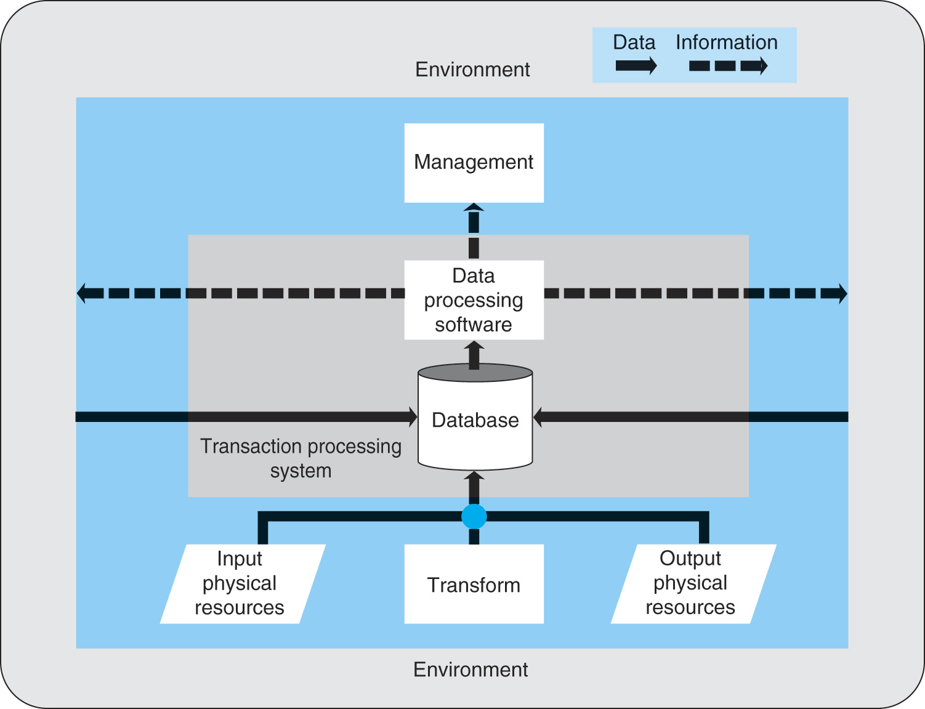
Figure 8.1 A Model of a Transaction Processing System

Slide 4
System Overview
Distribution system is a TPS used by distribution firms.
Distribution firms distribute products or services to their customers.
We will use data flow diagrams, or DFDs, to document the system.
Figure 8.2 represents the highest level.
Figure 8.3 identifies the three major subsystems.

Slide 5
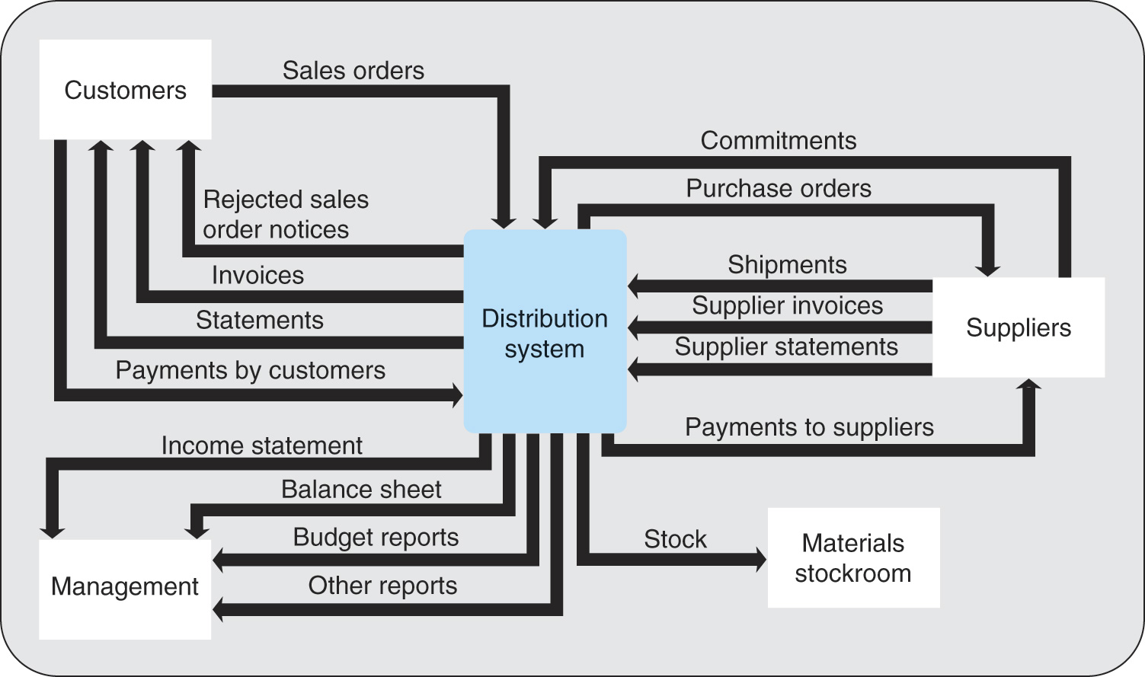
Figure 8.2 A Context Diagram of Distribution System

Slide 6
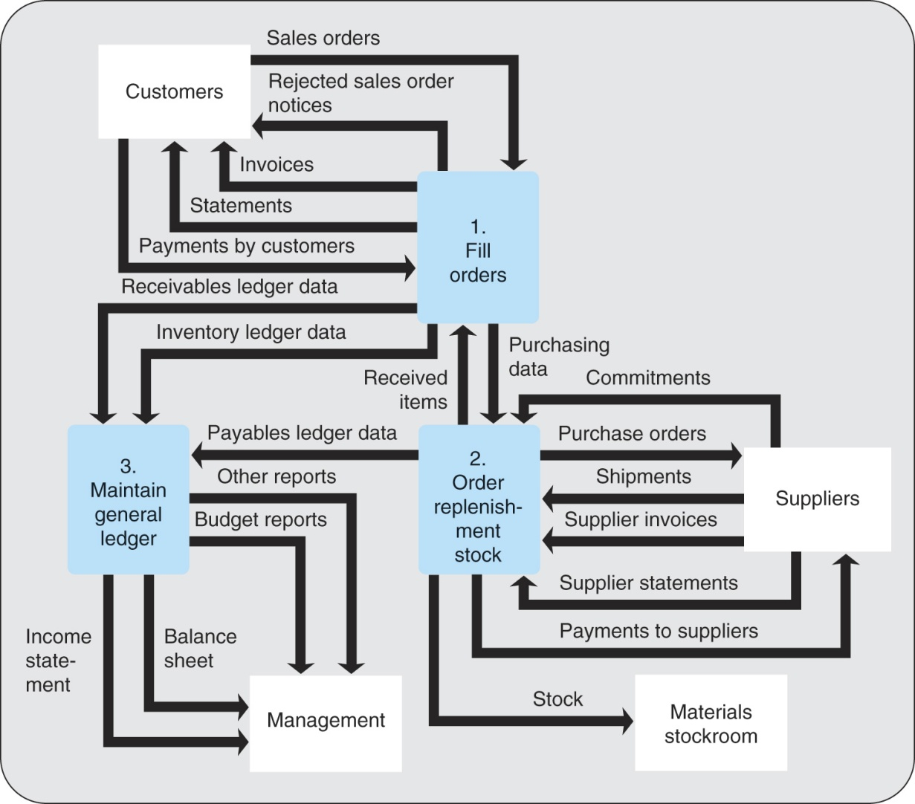
Figure 8.3 A Figure 0 Diagram of the Distribution System

Slide 7
Major Subsystems of Distribution System
Systems that fill customer orders.
  Order entry system enters customer orders into the system.
  Inventory system maintains the inventory records.
  Billing system prepares the customer invoices.
  Accounts receivable system collects the money from the customers.
Systems that order replenishment stock.
  Purchasing system issues purchase orders to suppliers for needed stock.
  Receiving system receives the stock.
  Accounts payable system makes payments.

Slide 8
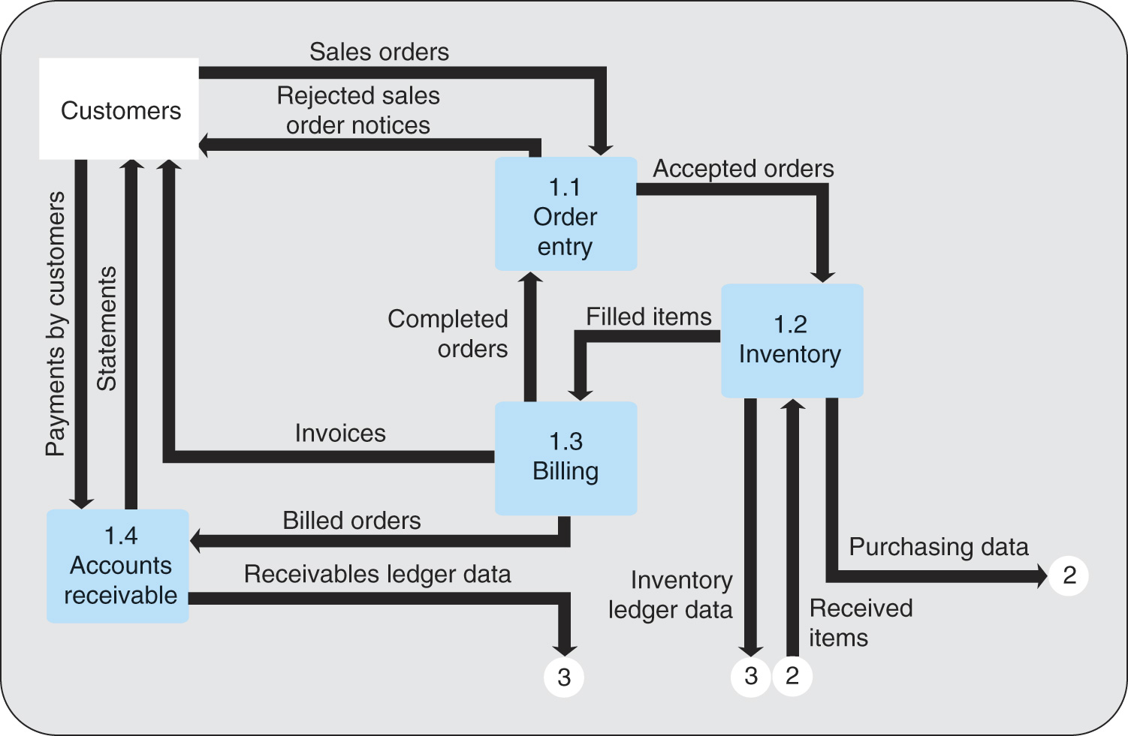
Figure 8.4 A Figure 1 Diagram of the System that Fills Customers Orders

Slide 9
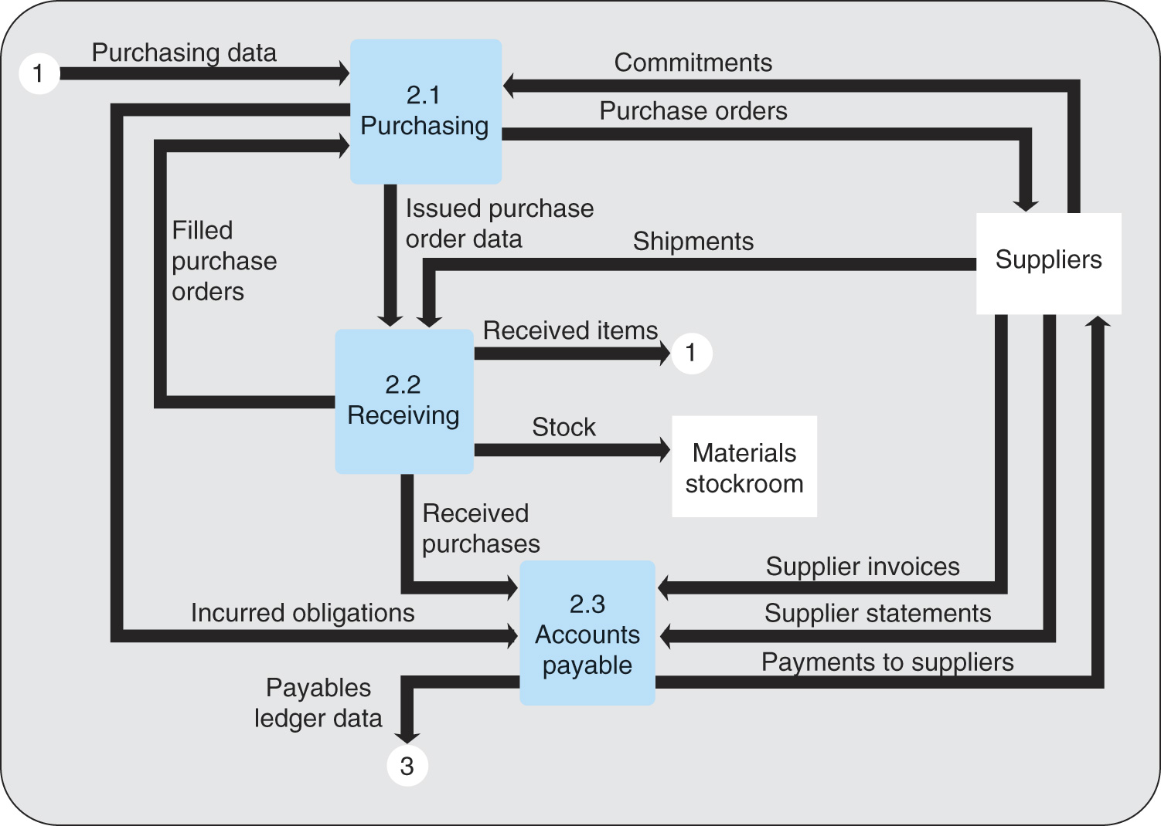
Figure 8.5 A Figure 2 Diagram of Systems That Order Replenishment Stock

Slide 10
Organizational Information Systems
Organizational information systems are developed to meet the needs for information relating to those particular parts of the organization.
Marketing information system (MKIS) provides information that relates to the firm’s marketing activities.
  Consists of a combination of input and output subsystems connected by a database.

Slide 11
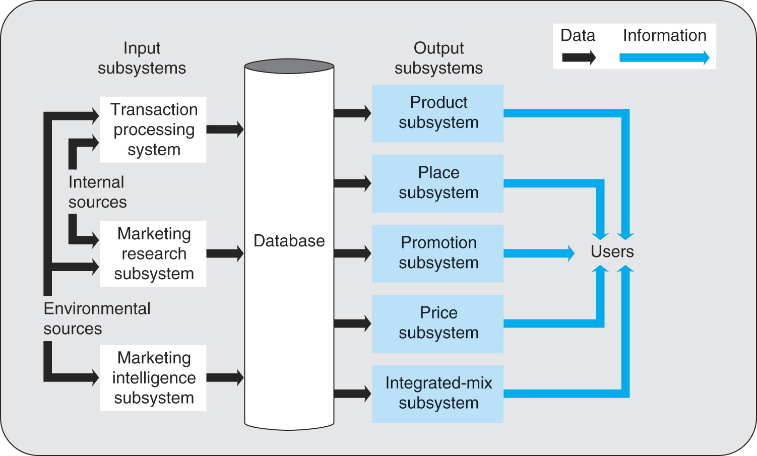
Figure 8.7 A Model of Marketing Information System

Slide 12
Marketing Information System
Output subsystems provide information about critical elements in marketing mix.
Marketing mix consists of four main ingredients that management manages in order to meet customers’ needs at a profit.
  Product subsystem provides information about the firm’s products.
  Place subsystem provides information about the firm’s distribution network.
  Promotion subsystem provides information about the firm’s advertising and personal selling activities.
  Price subsystem helps the manager make pricing decisions.
  Integrated-mix subsystem enables the manager to develop strategies that consider the combined effects of the ingredients.

Slide 13
Marketing Information System (Cont’d)
Database is populated with data from the three MKIS input subsystems.
Input subsystems
  Transaction processing system gathers data from both internal and environmental sources and enters the data into the database.
  Marketing research subsystem gathers internal and environmental data by conducting special studies.
  Marketing intelligence subsystem gathers environmental data that serves to keep management informed of activities of the firm’s competitors and customers and other elements that can influence marketing operations.

Slide 14
Other Organizational Information System
Human Resources information system (HRIS) provides information to managers throughout the firm concerning the firm’s human resources.
Manufacturing information system provides information to managers throughout the firm concerning the firm’s manufacturing operations.
Financial information system provides information to managers throughout the firm concerning the firm’s financial activities.

Slide 15
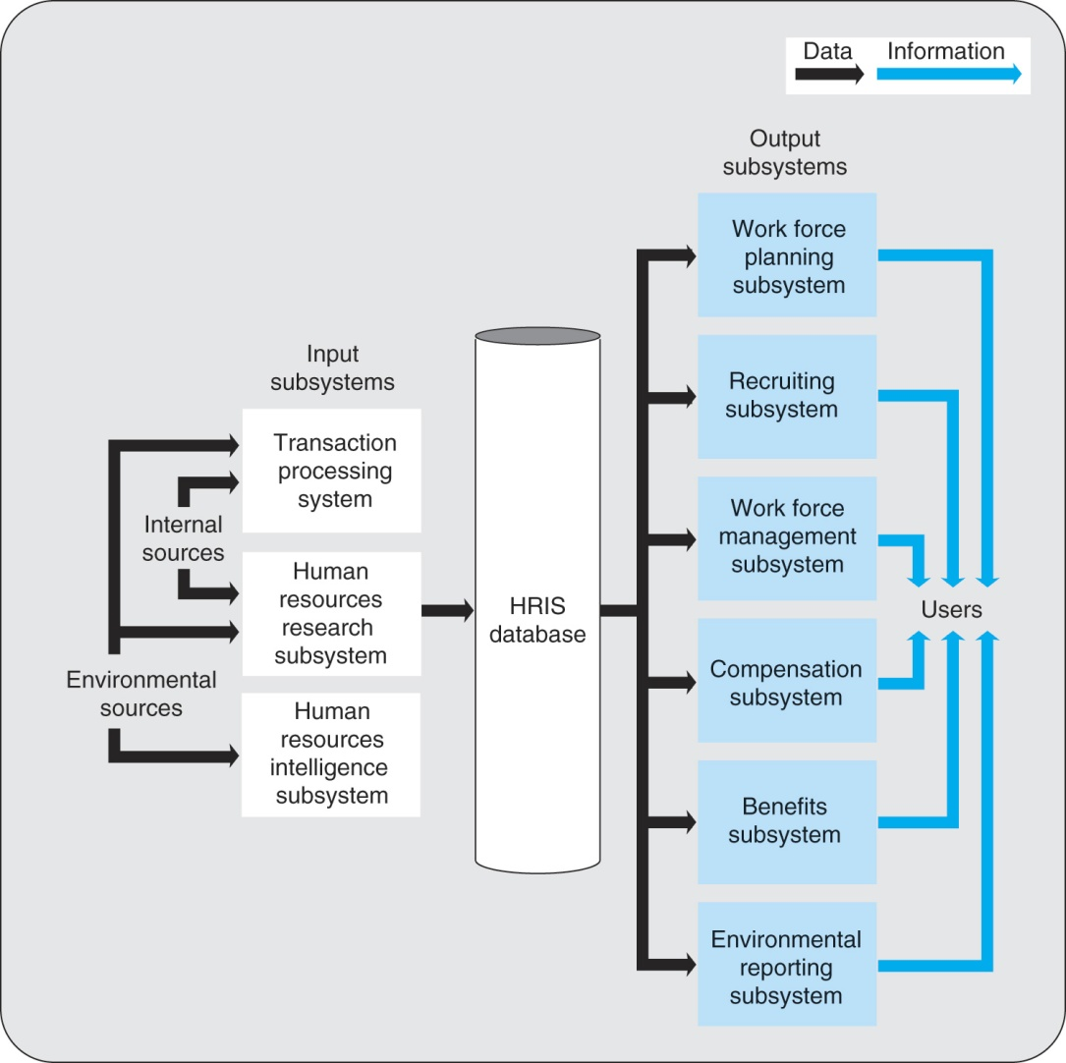
Figure 8.8 A Model of a Human Resource Information System

Slide 16
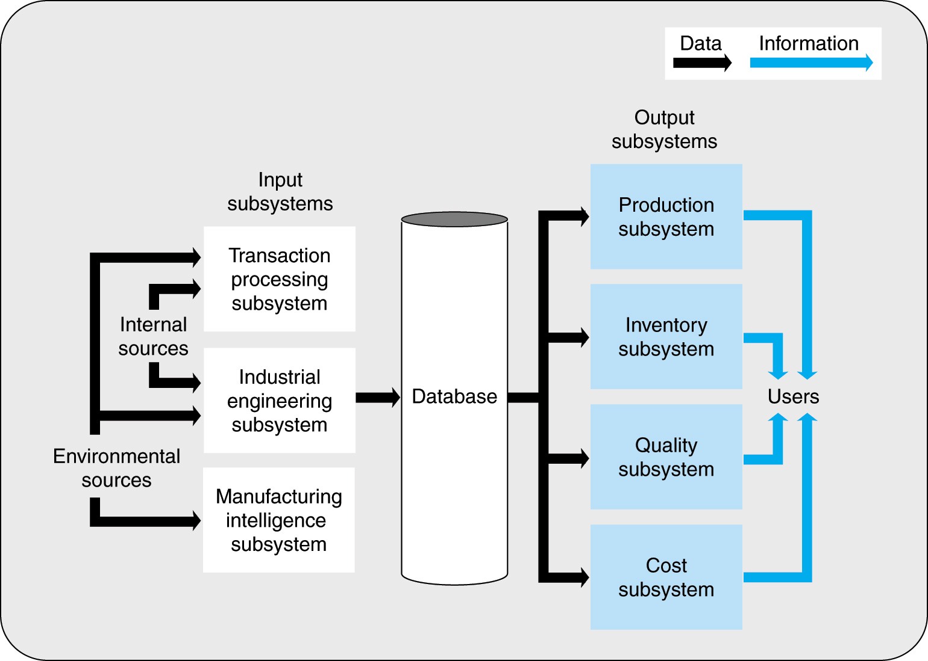
Figure 8.9 A Model of Manufacturing Information System

Slide 17
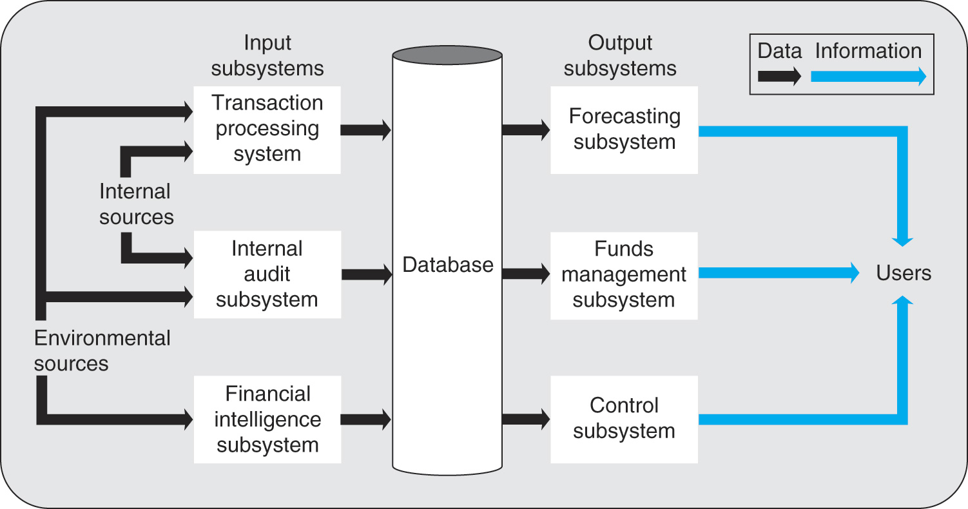
Figure 8.10 A Model of Financial Information System

Slide 18
The Executive Information System
Executive information system (EIS) is a system that provides information to upper-level managers on the overall performance of the firm; also called Executive support system (ESS).
Drill-down capability allows for executives to bring up a summary display and then successively display lower levels of detail until executives are satisfied that they have obtained as much detail as is necessary.

Slide 19
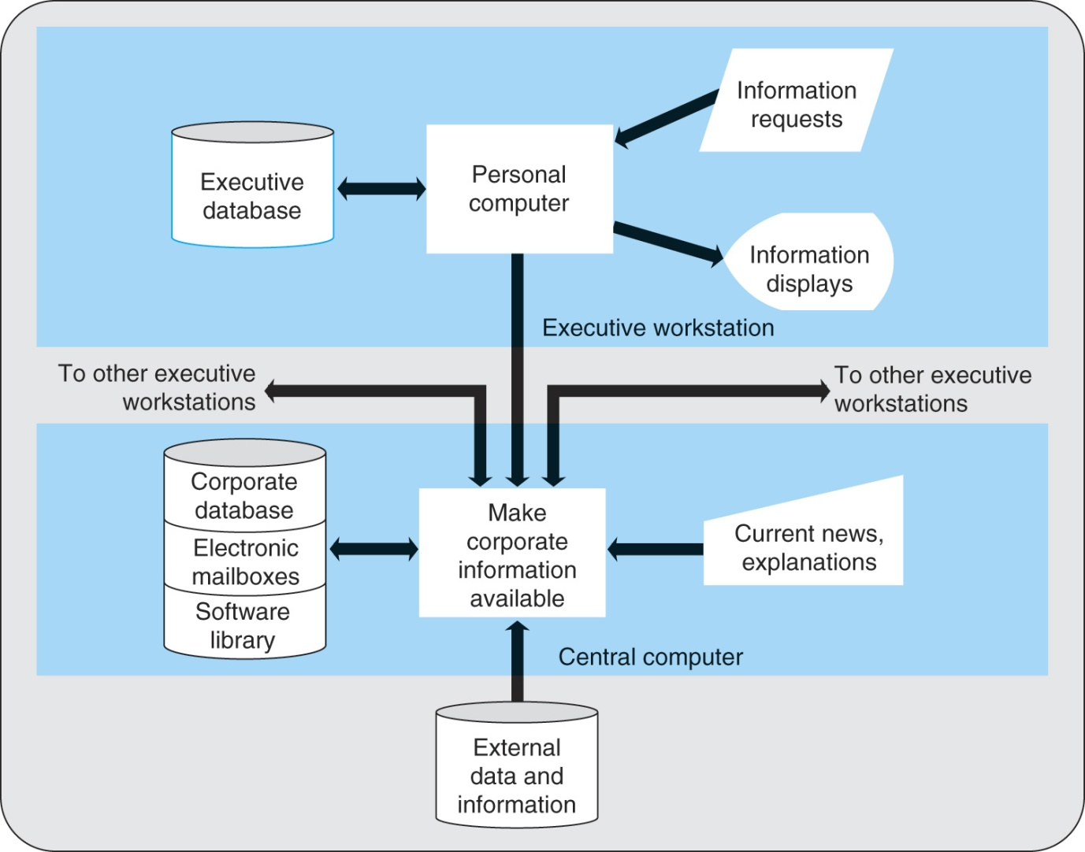
Figure 8.11 An Executive Information System Model

Slide 20
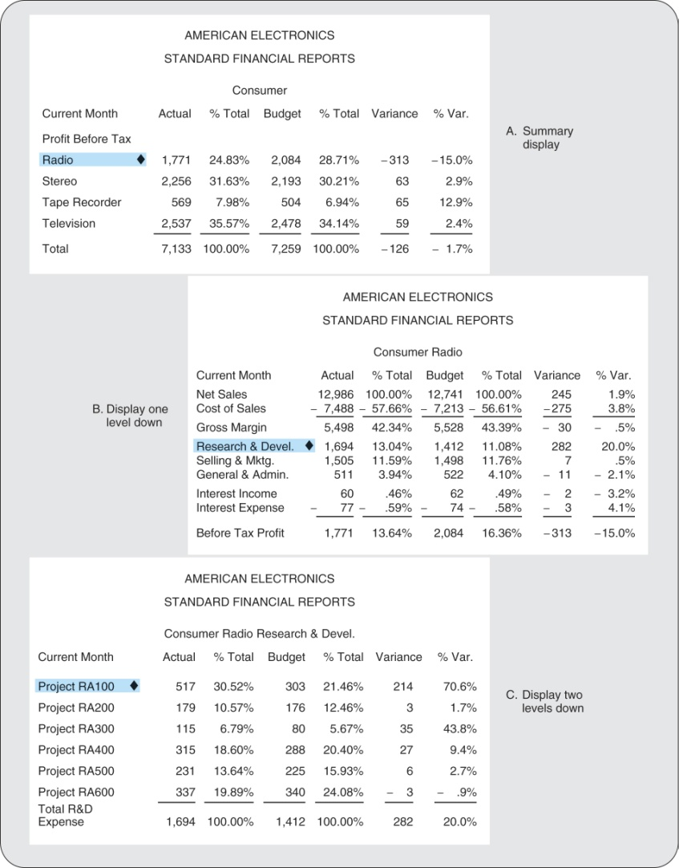
Figure 8.12 Drill-Down Technique

Slide 21
Data Warehousing
Data warehouse describes data storage that has the following characteristics:
  Storage capacity is very large.
  Data are accumulated by adding new records, as opposed to being kept current by updating existing records with new information.
  Date are easily retrievable.
  Date are used solely for decision making, not for use in the firm’s daily operations.
Data mart is a database that contains data describing only a segment of the firm’s operations.

