Slide 1
Overview of Financial Statement Analysis

Slide 2
Business Survival:
There are two key factors for business survival:
Profitability
Solvency
Profitability is important if the business is to generate revenue (income) in excess of the expenses incurred in operating that business.
The solvency of a business is important because it looks at the ability of the business in meeting its financial obligations.

Slide 3
Financial Statement Analysis
Financial Statement Analysis will help business owners and other interested people to analyse the data in financial statements to provide them with better information about such key factors for decision making and ultimate business survival.

Slide 4
Financial Statement Analysis
Purpose:
To use financial statements to evaluate an organisation’s
Financial performance
Financial position.
To have a means of comparative analysis across time in terms of:
Intracompany basis (within the company itself)
Intercompany basis (between companies)
Industry Averages (against that particular industry’s averages)
To apply analytical tools and techniques to financial statements to obtain useful information to aid decision making.

Slide 5
Profitability
Profitability measures look at how much profit the firm generates from sales or from its capital assets
Different measures of profit – gross and net
Gross profit – effectively total revenue (turnover) – variable costs (cost of sales)
Net Profit – effectively total revenue (turnover) – variable costs and fixed costs (overheads)

Slide 6
Profitability
Gross Profit Margin = Gross profit / turnover x 100
The higher the better
Enables the firm to assess the impact of its sales and how much it cost to generate (produce) those sales
A gross profit margin of 45% means that for every £1 of sales, the firm makes 45p in gross profit

Slide 7
Profitability
Net Profit Margin = Net Profit / Turnover x 100
Net profit takes into account the fixed costs involved in production – the overheads
Keeping control over fixed costs is important – could be easy to overlook for example the amount of waste - paper, stationery, lighting, heating, water, etc.
e.g. – leaving a photocopier on overnight uses enough electricity to make 5,300 A4 copies. (1,934,500 per year)
1 ream = 500 copies. 1 ream = £5.00 (on average)
Total cost therefore = £19,345 per year – or 1 person’s salary

Slide 8
Profitability Ratios
Gross Profit % = Gross Profit * 100
Net Sales
Net Profit % = Net Profit after tax * 100
Net Sales
Or in some cases, firms use the net profit before tax figure. Firms have no control over tax expense as they would have over other expenses.
Net Profit % = Net Profit before tax *100
Net Sales
Return on Assets = Net Profit * 100
Average Total Assets
Return on Equity = Net Profit *100
Average Total Equity

Slide 9
Return on Investment and the Du Pont Approach
Earning Power = Sales profitability X
Asset efficiency
ROI = Net profit margin X
Total asset turnover
ROI₂₀₀₇ = .041 x 1.02 = .042 or 4.2%
ROI_{Industry} = .082 x 1.17 = .098 or 9.8%

Slide 10
Return on Equity and the Du Pont Approach
Return On Equity = Net profit margin X
Total asset turnover X
Equity Multiplier
Total Assets
Equity Multiplier =
Shareholders’ Equity
ROE₂₀₀₇ = .041 x 1.02 x 1.90 = .080
ROE_{Industry} = .082 x 1.17 x 1.88 = .179

Slide 11
Business Analysis
Evaluate Prospects
Evaluate Risks
Business Decision Makers
Equity investors
Creditors
Managers
Merger and Acquisition Analysts
External Auditors
Directors
Regulators
Employees & Unions
Lawyers
Notes:
11

Slide 12
Information Sources for Business Analysis
Quantitative
Financial Statements
Industry Statistics
Economic Indicators
Regulatory filings
Trade reports
Qualitative
Management discussion & Analysis
Chairperson’s Letter
Press Releases
Financial press
Vision/Mission Statement
Web sites
Notes:
12

Slide 13
Credit Analysis
Equity Analysis
Management &
Control
Labor Negotiations
Types of
Business
Analysis
Regulation
Director Oversight
Financial
Management
External Auditing
Mergers, Acquisitions
& Divestitures
Notes:
13

Slide 14
Financial Statements Reflect Business Activities
Planning
Investing
Current:
Cash
Accounts Receivable
Inventories
Marketable Securities
Noncurrent:
Land, Buildings, & Equipment
Patents
Investments
Financing
Current:
Notes Payable
Accounts Payable
Salaries Payable
Income Tax Payable
Noncurrent:
Bonds Payable
Common Stock
Retained Earnings
Operating
Sales
Cost of Goods Sold
Selling Expense
Administrative Expense
Interest Expense
Income Tax Expense
Net Income
Income statement
Liabilities & Equity
Assets
Cash Flow
Balance Sheet
Balance Sheet
Statement of
Cash Flows
Statement of Shareholders’ Equity
Notes:
14

Slide 15
Financial Statements
Balance Sheet
Income Statement
Statement of Shareholders’ Equity
Statement of Cash Flows
Notes:
15

Slide 16
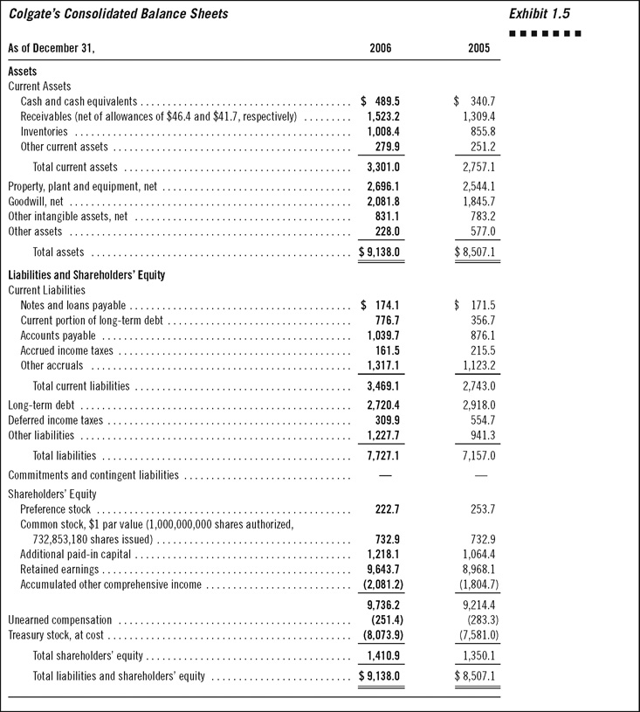
1-16
Notes:
16

Slide 17
Balance Sheet
Total Investing = Total Financing
= Creditor Financing + Owner Financing
Colgate Financing
(in $billions)
$9.138 = $7.727 + $1.410
Notes:
17

Slide 18
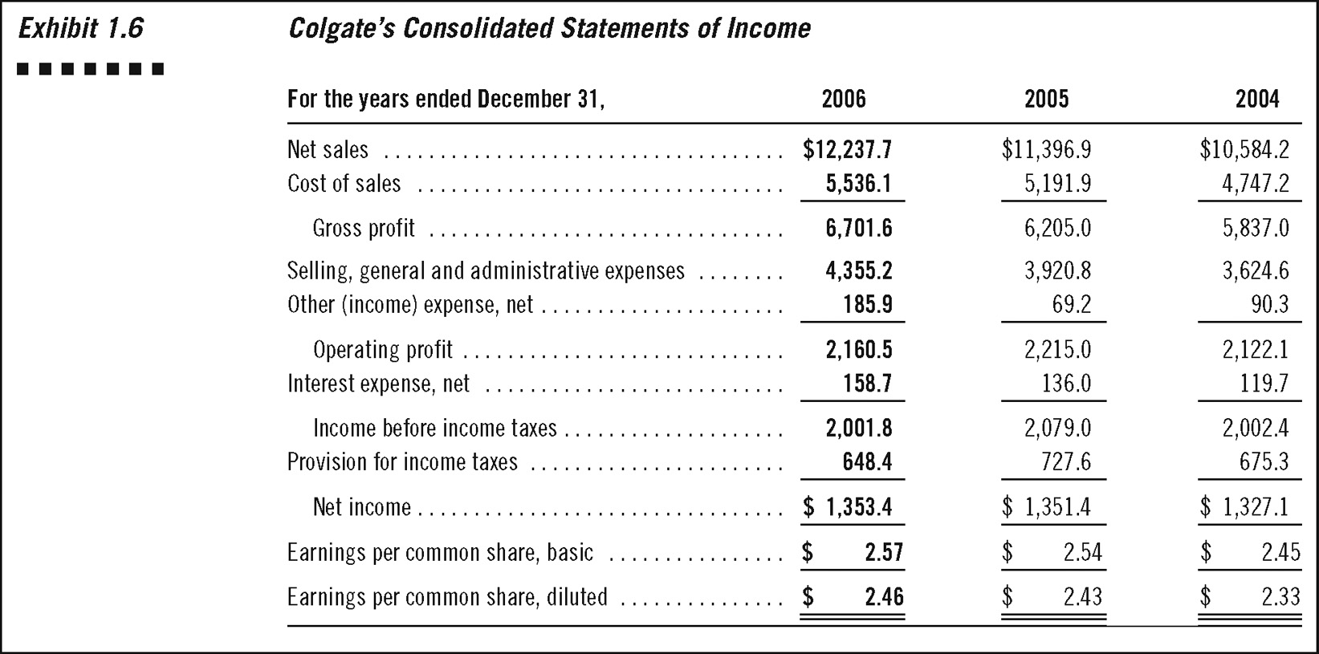
1-18
Notes:
18

Slide 19
Income Statement
Revenues – Cost of goods sold = Gross Profit
Gross profit – Operating expenses = Operating Profit
Colgate’s Profitability
(in $billions)
$12.238 - $5.536 = $6.701 Gross Profit
$6.701 - $4.5411 = $2.160 Operating profit
Notes:
19

Slide 20
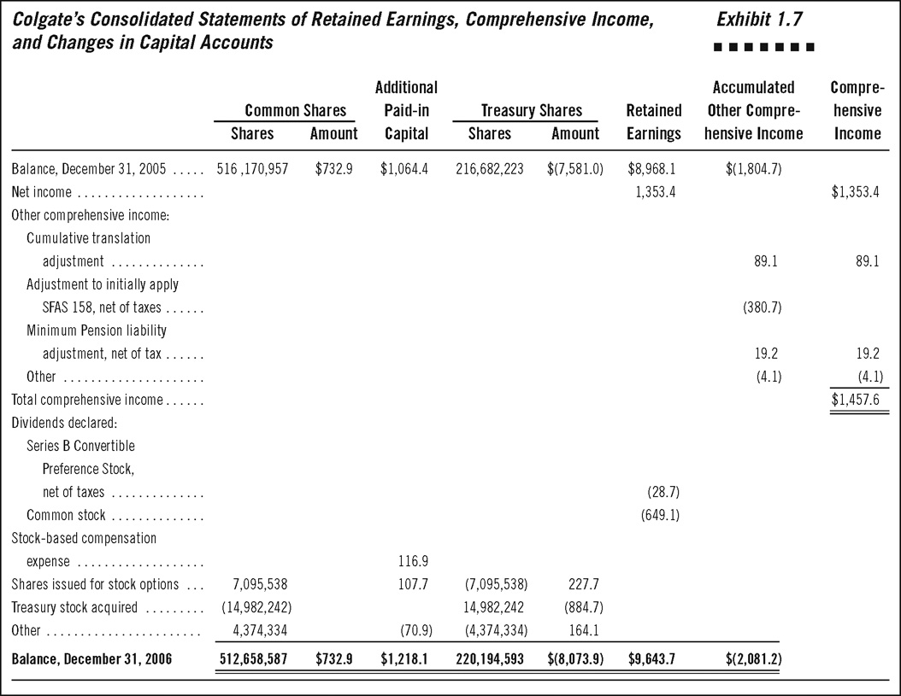
1-20
Notes:
20

Slide 21
Statement of Cash Flows
Net Cash Flows from Operating Activities
Net Cash Flows from Investing Activities
Net Cash Flows from Financing Activities
Notes:
21

Slide 22
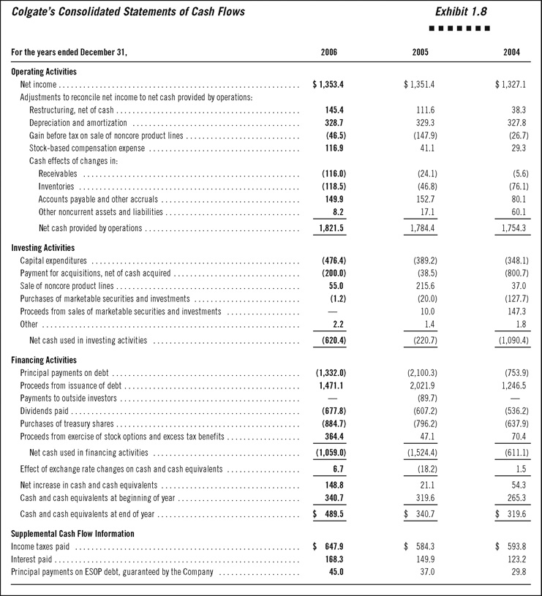
1-22
Notes:
22

