Slide 1
International Factor Movements
Fanny Widadie
Jurusan Sosial Ekonomi Pertanian – Agribisnis
Fakultas Pertanian
Universitas Sebelas Maret

Slide 2
Chapter Organization
Introduction
International Labor Mobility
International Borrowing and Lending
Direct Foreign Investment and Multinational Firms
Summary
Appendix: More on Intertemporal Trade

Slide 3
Introduction
Movement of goods and services is one form of international integration.
Another form of integration is international movements of factors of production (factor movements).
Factor movements include:
Labor migration
Transfer of capital via international borrowing and lending
International linkages involved in the formation of multinational corporations

Slide 4
International Labor Mobility
A One-Good Model Without Factor Mobility
Assumptions of the model:
There are two countries (Home and Foreign).
There are two factors of production: Land (T) and Labor (L).
Both countries produce only one good (refer to it as “output”).
Both countries have the same technology but different overall land-labor ratios.
Home is the labor-abundant country and Foreign is the land-abundant country.
Perfect competition prevails in all markets.

Slide 5
International Labor Mobility
An Economy’s Production Function
Output, Q
Q (T, L)
Labor, L

Slide 6
International Labor Mobility
Figure 7-2: The Marginal Product of Labor
Marginal Product of labor, MPL
Rents
Real
wage
Wages
MPL
Labor, L

Slide 7
International Labor Mobility
International Labor Movement
Suppose that workers are able to move between the two countries.
Home workers would like to move to Foreign until the marginal product of labor is the same in the two countries.
This movement will reduce the Home labor force and thus raise the real wage in Home.
This movement will increase the Foreign labor force and reduce the real wage in Foreign.

Slide 8
International Labor Mobility
Causes and Effects of International Labor Mobility
MPL
Marginal product
of labor
MPL*
B
A
C
MPL
MPL*
Home
employment
Foreign
employment
O
L²
L¹
O*
Migration of labor
from Home to Foreign
Total world labor force

Slide 9
International Labor Mobility
The redistribution of the world’s labor force:
Leads to a convergence of real wage rates
Increases the world’s output as a whole
Leaves some groups worse off
Extending the Analysis
Modifying the model by adding some complications:
Suppose the countries produce two goods, one labor- intensive and one land-intensive.
Trade offers an alternative to factor mobility: Home can export labor and import land by exporting the labor-intensive good and importing the land-intensive good.

Slide 10
International Borrowing and Lending
International movements of capital
Refer to borrowing and lending between countries
Example: A U.S. bank lends to a Mexican firm.
Can be interpreted as intertemporal trade
Refers to trade of goods today for goods in the future

Slide 11
International Borrowing and Lending
Intertemporal Production Possibilities and Trade
Imagine an economy that consumes only one good and will exist for only two periods, which we will call present and future.
Intertemporal production possibility frontier
It represents a trade-off between present and future production of the consumption good.
Its shape will differ among countries:
Some countries will be biased toward present output.
Some countries will be biased toward future output.

Slide 12
International Borrowing and Lending
The Intertemporal Production Possibility Frontier
Future
consumption
Present
consumption

Slide 13
International Borrowing and Lending
The Real Interest Rate
How does a country trade over time?
A country can trade over time by borrowing or lending.
When a country borrows, it gets the right to purchase some quantity of consumption at present in return for repayment of some larger quantity in the future.
The quantity of repayment in future will be (1 + r) times the quantity borrowed in present, where r is the real interest rate on borrowing.
The relative price of future consumption is 1/(1 + r).

Slide 14
International Borrowing and Lending
Intertemporal Comparative Advantage
Assume that Home’s intertemporal production possibilities are biased toward present production.
A country that has a comparative advantage in future production of consumption goods is one that in the absence of international borrowing and lending would have a low relative price of future consumption (i.e., high real interest rate).
High interest rate corresponds to a high return on investment.

Slide 15
Direct Foreign Investment and Multinational Firms
Direct foreign investment
Refers to international capital flows in which a firm in one country creates or expands a subsidiary in another
Involves not only a transfer of resources but also the acquisition of control
The subsidiary does not simply have a financial obligation to the parent company; it is part of the same organizational structure.

Slide 16
Direct Foreign Investment and Multinational Firms
Multinational firms
A vehicle for international borrowing and lending
They provide financing to their foreign subsidiaries
Why is direct foreign investment rather than some other way of transferring funds chosen?
To allow the formation of multinational organization (extension of control)
Why do firms seek to extend control?
The answer is summarized under the theory of multinational enterprise.

Slide 17
Direct Foreign Investment and Multinational Firms
The Theory of Multinational Enterprise
Two elements explain the existence of a multinational:
Location motive
A good is produced in two (or more) different countries rather than one because of:
Resources
Transport costs
Barriers of trade
Internalization motive
A good is produced in different locations by the same firm rather than by separate firms because it is more profitable to carry transactions on technology and management.
Technology transfer
Vertical integration

Slide 18
Direct Foreign Investment and Multinational Firms
Multinational Firms in Practice
Multinational firms play an important part in world trade and investment.
Example: Half of U.S. imports can be regarded as transactions between branches of multinational firms, and 24% of U.S. assets abroad consist of the value of foreign subsidiaries of U.S. firms.
Multinational firms may be either domestic or foreign-owned.
Foreign-owned multinational firms play an important role in most economies, especially in the United States.

Slide 19
Direct Foreign Investment and Multinational Firms
Table 7-1: France, United Kingdom, and United States: Shares of Foreign-Owned Firms in Manufacturing Sales, Value Added, and Employment, 1985 and 1990 (percentages)

Slide 20
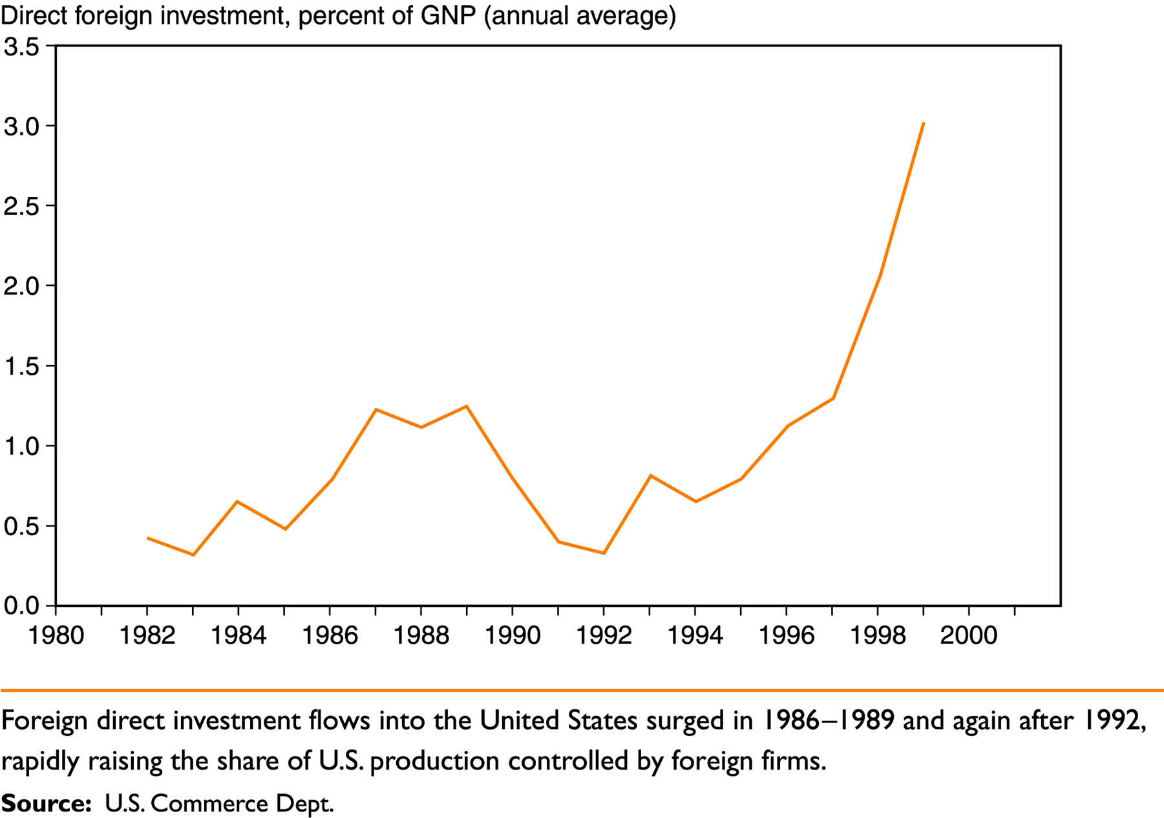
Direct Foreign Investment and Multinational Firms
Figure 7-5: Foreign Direct Investment in the United States

Slide 21
Summary
International factor movements can sometimes substitute for trade.
International borrowing and lending can be viewed as a kind of international trade of present consumption for future consumption rather than trade of one good for another.
Multinational firms primarily exist as ways of extending control over activities taking place in two or more different countries.

Slide 22
Summary
Two elements explain the existence of a multinational:
A location motive.
An internalization motive.

Slide 23
Appendix: More on Intertemporal Trade
Figure 7A-1: Determining Home’s Intertemporal Production Pattern
Future
consumption
Isovalue lines with slope – (1 + r)
QF
Q
Intertemporal
production
possibility
frontier
QP
Present
consumption
Investment

Slide 24
Appendix: More on Intertemporal Trade
Figure 7A-2: Determining Home’s Intertemporal Consumption Pattern
Future
consumption
Indifference curves
D
DF
Imports
QF
Q
Intertemporal budget constraint,
DP + DF/(1 + r) = QP +QF/(1 + r)
DP
QP
Present
consumption
Exports

Slide 25
Appendix: More on Intertemporal Trade
Figure 7A-3: Determining Foreign’s Intertemporal Production and Consumption Patterns
Future
consumption
Q*
Q*F
Exports
D*
D*F
Intertemporal budget constraint,
D*P + D*F/(1 + r) = Q*P +Q*F/(1 + r)
Q*P
D*P
Present
consumption
Imports

Slide 26
SELAMAT BELAJAR

