Slide 1
The Political Economy of Trade Policy
Fanny Widadie
Jurusan Sosial Ekonomi Pertanian
Ekonomi Internasional

Slide 2
Introduction
Free trade maximizes national welfare, but it is associated with income distributional effects.
  Most governments maintain some form of restrictive trade policies.
  This chapter examines some of the reasons governments either should not or do not base their policy on economists’ cost-benefit calculations.

Slide 3
Introduction
What reasons are there for governments not to interfere with trade?
  There are three arguments in favor of free trade:
    Free trade and efficiency
    Economies of scale in production
    Political argument

Slide 4
The Case for Free Trade
Free Trade and Efficiency
  The efficiency argument for free trade is based on the result that in the case of a small country, free trade is the best policy.
    A tariff causes a net loss to the economy.
    A move from a tariff equilibrium to free trade eliminates the efficiency loss and increases national welfare.

Slide 5
The Case for Free Trade
Figure 9-1: The Efficiency Case for Free Trade
Price, P
S
Production
distortion
Consumption
distortion
World price
plus tariff
World price
D
Quantity, Q

Slide 6
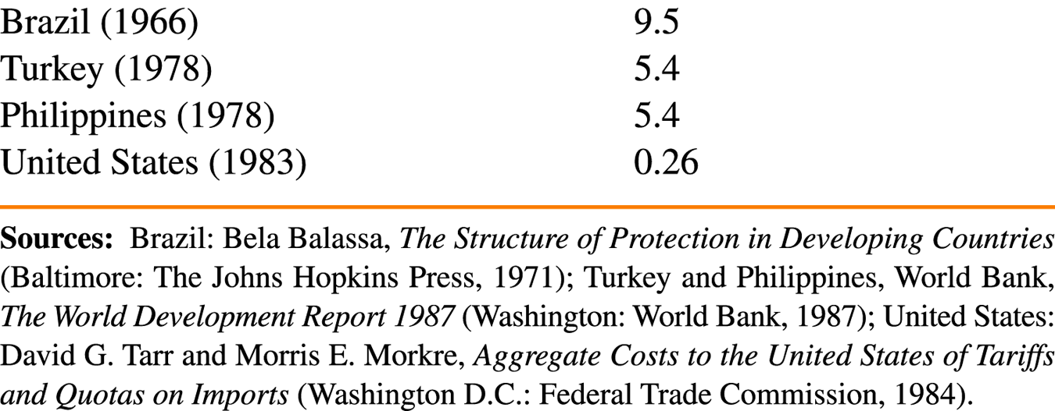
The Case for Free Trade
Table 9-1: Estimated Cost of Protection,
as a Percentage of National Income

Slide 7
The Case for Free Trade
Additional Gains from Free Trade
  Protected markets in small countries do not allow firms to exploit scale economies.
    Example: In the auto industry, an efficient scale assembly should make a minimum of 80,000 – 200,000 cars per year.
      In Argentina, 13 firms produced a total of 166,000 cars per year.
  The presence of scale economies favors free trade that generates more varieties and results in lower prices.
  Free trade, as opposed to “managed” trade, provides a wider range of opportunities and thus a wider scope for innovation.

Slide 8
The Case for Free Trade
Political Argument for Free Trade
  A political commitment to free trade may be a good idea in practice.
  Trade policies in practice are dominated by special-interest politics rather than consideration of national costs and benefits.

Slide 9
National Welfare Arguments
Against Free Trade
Activist trade policies can sometimes increase the welfare of the nation as a whole.
There are two theoretical arguments against the policy of free trade:
  The terms of trade argument for a tariff
  The domestic market failure

Slide 10
National Welfare Arguments
Against Free Trade
The Terms of Trade Argument for a Tariff
  For a large country (that is, a country that can affect the world price through trading), a tariff lowers the price of imports and generates a terms of trade benefit.
    This benefit must be compared to the costs of the tariff (production and consumption distortions).
  It is possible that the terms of trade benefits of a tariff outweigh its costs.
    Therefore, free trade might not be the best policy for a large country.

Slide 11
National Welfare Arguments
Against Free Trade
Figure 9-2: The Optimum Tariff
National welfare
1
Optimum
tariff, t_{o}
Prohibitive
tariff rate, t_{p}
Tariff rate

Slide 12
National Welfare Arguments
Against Free Trade
  Optimum tariff
    The tariff rate that maximizes national welfare
    It is always positive but less than the prohibitive rate that would eliminate all imports.
    It is zero for a small country because it cannot affect its terms of trade.

Slide 13
National Welfare Arguments
Against Free Trade
  What policy would the terms of trade argument dictate for export sectors?
    An export subsidy worsens the terms of trade, and therefore unambiguously reduces national welfare.
      Therefore, the optimal policy in export sectors must be a negative subsidy, that is, a tax on exports.
    Like the optimum tariff, the optimum export tax is always positive but less than the prohibitive tax that would eliminate exports completely.

Slide 14
National Welfare Arguments
Against Free Trade
The Domestic Market Failure Argument Against Free Trade
  Producer and consumer surplus do not properly measure social costs and benefits.
    Consumer and producer surplus ignore domestic market failures such as:
      Unemployment or underemployment of labor
      Technological spillovers from industries that are new or particularly innovative
      Environmental externalities
  A tariff may raise welfare if there is a marginal social benefit to production of a good that is not captured by producer surplus measures.

