Slide 1
National Income Accounting and
the Balance of Payments

Slide 2
Chapter Organization
Introduction
The National Income Accounts
National Income Accounting for an Open Economy
The Balance of Payment Accounts
Summary

Slide 3
Introduction
Microeconomics
It studies the effective use of scarce resources from the perspective of individual firms and consumers.
Macroeconomics
It studies how economies’ overall levels of employment, production, and growth are determined.
It emphasizes four aspects of economic life:
Unemployment
Saving
Trade imbalances
Money and the price level

Slide 4
Introduction
The national income accounts and the balance of payments accounts are essential tools for studying the macroeconomics of open, interdependent economies.
National income accounting
Records all the expenditures that contribute to a country’s income and output
Balance of payments accounting
Helps us keep track of both changes in a country’s indebtedness to foreigners and the fortunes of its export- and import-competing industries

Slide 5
The National Income Accounts
Gross national product (GNP)
The value of all final goods and services produced by a country’s factors of production and sold on the market in a given time period
It is the basic measure of a country’s output.

Slide 6
The National Income Accounts
GNP is calculated by adding up the market value of all expenditures on final output:
Consumption
The amount consumed by private domestic residents
Investment
The amount put aside by private firms to build new plant and equipment for future production
Government purchases
The amount used by the government
Current account balance
The amount of net exports of goods and services to foreigners

Slide 7
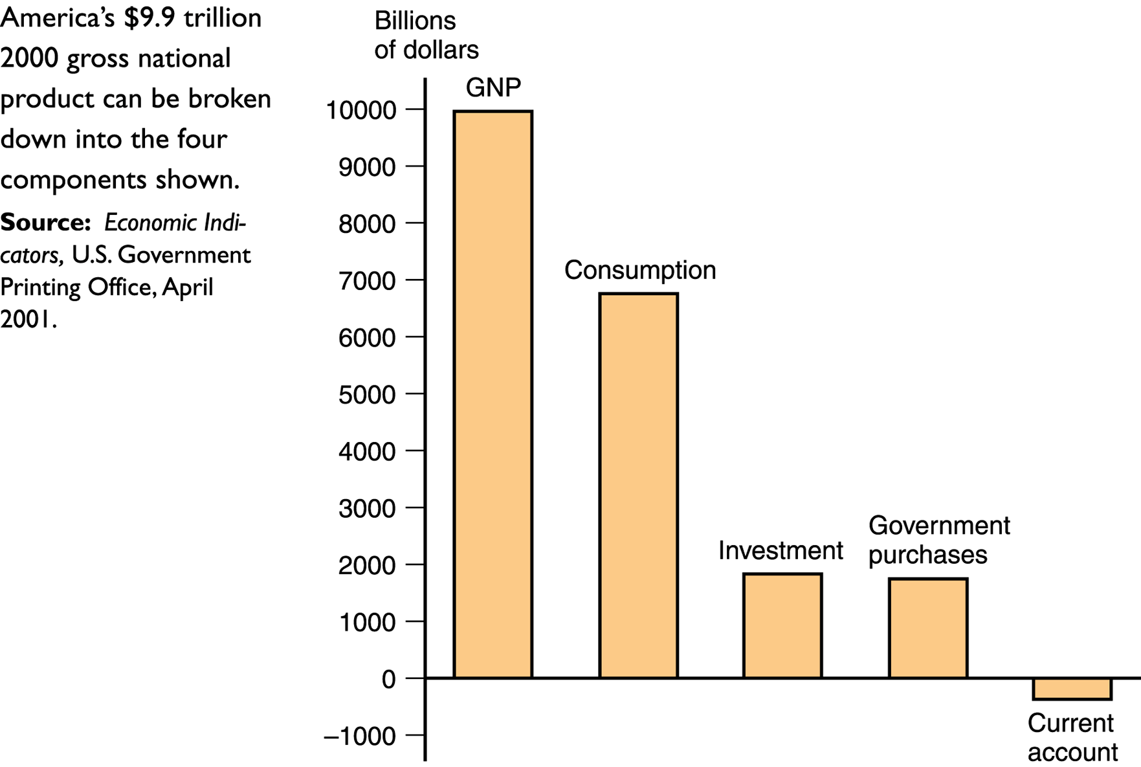
The National Income Accounts
Figure 12-1: U.S. GNP and Its Components, 2000

Slide 8
The National Income Accounts
National Product and National Income
National Income
It is earned over a period by its factors of production.
It must equal the GNP a country generates over some period of time.
One person’s spending is another’s income (i.e., total spending must equal total income).

Slide 9
The National Income Accounts
Capital Depreciation, International Transfers, and Indirect Business Taxes
Adjustments to the definition of GNP:
Depreciation of capital
It reduces the income of capital owners.
It must be subtracted from GNP (to get the net national product).
Net unilateral transfers of income
They are part of a country’s income but are not part of its product.
They must be added to the net national product.
Indirect business taxes
They are sales taxes.
They must be subtracted from GNP.

Slide 10
The National Income Accounts
Gross Domestic Product (GDP)
It measures the volume of production within a country’s borders.
It equals GNP minus net receipts of factor income from the rest of the world.
It does not correct for the portion of countries’ production carried out using services provided by foreign-owned capital.

Slide 11
National Income Accounting for an Open Economy
Consumption
The portion of GNP purchased by the private sector to fulfill current wants
Investment
The part of output used by private firms to produce future output
Government Purchases
Any goods and services purchased by federal, state, or local governments

Slide 12
National Income Accounting for an Open Economy
The National Income Identity for an Open Economy
It is the sum of domestic and foreign expenditure on the goods and services produced by domestic factors of production:
Y = C + I + G + EX – IM (12-1)
where:
Y is GNP
C is consumption
I is investment
G is government purchases
EX is exports
IM is imports
In a closed economy, EX = IM = 0.

Slide 13
National Income Accounting for an Open Economy
An Imaginary Open Economy
Assumptions of the model:
There is an economy, Agraria, that can only produce wheat.
Each citizen of Agraria is both a consumer and a farmer of wheat.
The Agrarian government appropriates part of the crop to feed its army.
Agraria can import milk from the rest of the world in exchange for exports of wheat.
The price of milk is 0.5 bushel of wheat per gallon, and at this price Agrarians want to consume 40 gallons of milk.

Slide 14
National Income Accounting for an Open Economy
Table 12-1: National Income Accounts for Agraria, an Open Economy (bushels of wheat)

Slide 15
National Income Accounting for an Open Economy
The Current Account and Foreign Indebtedness
Current account (CA) balance
The difference between exports of goods and services and imports of goods and services (CA = EX – IM)
A country has a CA surplus when its CA > 0.
A country has a CA deficit when its CA < 0.
CA measures the size and direction of international borrowing.
A country’s current account balance equals the change in its net foreign wealth.

Slide 16
National Income Accounting for an Open Economy
CA balance is equal to the difference between national income and domestic residents’ spending:
Y – (C+ I + G) = CA
CA balance is goods production less domestic demand.
CA balance is the excess supply of domestic financing.
Example: Agraria imports 20 bushels of wheat and exports only 10 bushels of wheat (Table 12-1). The current account deficit of 10 bushels is the value of Agraria’s borrowing from foreigners, which the country will have to repay in the future.

Slide 17
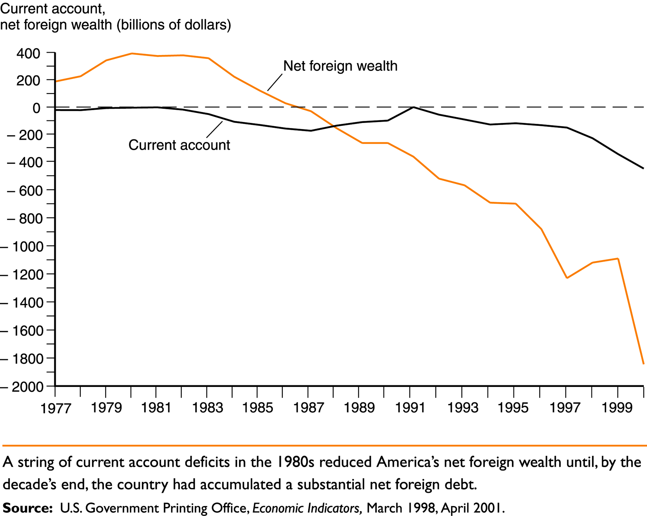
National Income Accounting for an Open Economy
Figure 12-2: The U.S. Current Account and Net Foreign Wealth Position, 1977-2000

Slide 18
National Income Accounting for an Open Economy
Saving and the Current Account
National saving (S)
The portion of output, Y, that is not devoted to household consumption, C, or government purchases, G.
It always equals investment in a closed economy.
A closed economy can save only by building up its capital stock (S = I).
An open economy can save either by building up its capital stock or by acquiring foreign wealth (S = I + CA).
A country’s CA surplus is referred to as its net foreign investment.

Slide 19
National Income Accounting for an Open Economy
Private and Government Saving
Private saving (S^{p})
The part of disposable income that is saved rather than consumed
S^{p} = I + CA – S^{g} = I + CA – (T – G) = I + CA + (G – T) (12-2)
T is the government's “income” (its net tax revenue)
S^{g} is government savings (T-G)
Government budget deficit (G – T)
It measures the extent to which the government is borrowing to finance its expenditures.

Slide 20
The Balance of Payments Accounts
A country’s balance of payments accounts keep track of both its payments to and its receipts from foreigners.
Every international transaction automatically enters the balance of payments twice: once as a credit (+) and once as a debit (-).

Slide 21
The Balance of Payments Accounts
Three types of international transactions are recorded in the balance of payments:
Exports or imports of goods or services
Purchases or sales of financial assets
Transfers of wealth between countries
They are recorded in the capital account.

Slide 22
The Balance of Payments Accounts
Examples of Paired Transactions
A U.S. citizen buys a $1000 typewriter from an Italian company, and the Italian company deposits the $1000 in its account at Citibank in New York.
That is, the U.S. trades assets for goods.
This transaction creates the following two offsetting entries in the U.S. balance of payments:
It enters the U.S. CA with a negative sign (-$1000).
It shows up as a $1000 credit in the U.S. financial account.

Slide 23
The Balance of Payments Accounts
A U.S. citizen pays $200 for dinner at a French restaurant in France by charging his Visa credit card.
That is, the U.S. trades assets for services.
This transaction creates the following two offsetting entries in the U.S. balance of payments:
It enters the U.S. CA with a negative sign (-$200).
It shows up as a $200 credit in the U.S. financial account.

Slide 24
The Balance of Payments Accounts
A U.S. citizen buys a $95 newly issued share of stock in the United Kingdom oil giant British Petroleum (BP) by using a check drawn on his stockbroker money market account. BP deposits the $95 in its own U.S. bank account at Second Bank of Chicago.
That is, the U.S. trades assets for assets.
This transaction creates the following two offsetting entries in the U.S. balance of payments:
It enters the U.S. financial account with a negative sign (-$95).
It shows up as a $95 credit in the U.S. financial account.

Slide 25
The Balance of Payments Accounts
A U.S. bank forgives $5000 in debt owed to it by the government of Bygonia.
This transaction creates the following two offsetting entries in the U.S. balance of payments:
It enters the U.S. capital account with a negative sign (-$5000).
It shows up as a $5000 credit in the U.S. financial account.

Slide 26
The Balance of Payments Accounts
The Fundamental Balance of Payments Identity
Any international transaction automatically gives rise to two offsetting entries in the balance of payments resulting in a fundamental identity:
Current account + financial account + capital account = 0 (12-3)

Slide 27
The Balance of Payments Accounts
Table 12-2: U.S. Balance of Payments Accounts for 2000
(billions of dollars)

Slide 28
The Balance of Payments Accounts
Table 12-2: Continued

Slide 29
The Balance of Payments Accounts
The Current Account, Once Again
The balance of payments accounts divide exports and imports into three categories:
Merchandise trade
Exports or imports of goods
Services
Payments for legal assistance, tourists’ expenditures, and shipping fees
Income
International interest and dividend payments and the earnings of domestically owned firms operating abroad

Slide 30
The Balance of Payments Accounts
The Capital Account
It records asset transfers and tends to be small for the United States.
The Financial Account
It measures the difference between sales of assets to foreigners and purchases of assets located abroad.
Financial inflow (capital inflow)
A loan from the foreigners with a promise that they will be repaid
Financial outflow (capital outflow)
A transaction involving the purchase of an asset from foreigners

Slide 31
The Balance of Payments Accounts
Case Study: Is the United States the World’s Biggest Debtor?
At the end of 1999, the United States had a negative net foreign wealth position far greater than that of any other single country.
The United States is the world’s biggest debtor.
However, the United States has the world’s largest GNP.

Slide 32
Summary
A country’s GNP is equal to the income received by its factors of production.
GDP is equal to GNP less net receipts of factor income from abroad, measures the output produced within a country’s territorial borders.
In a closed economy, GNP must be consumed, invested, or purchased by the government.
In an open economy, GNP equals the sum of consumption, investment, government purchases, and net exports of goods and services.

Slide 33
Summary
All transactions between a country and the rest of the world are recorded in its balance of payments accounts.
The current account equals the country’s net lending to foreigners.
National saving equals domestic investment plus the current account.
Transactions involving goods and services appear in the current account of the balance of payments, while international sales or purchases of assets appear in the financial account.

Slide 34
Summary
The capital account records asset transfers and tends to be small in the United States.
Any current account deficit must be matched by an equal surplus in the other two accounts of the balance of payments, and any current account surplus by a deficit somewhere else.
International asset transactions carried out by central banks are included in the financial account.

