Slide 1
Economies of Scale, Imperfect Competition,
and International Trade

Slide 2
Chapter Organization
Introduction
Economies of Scale and International Trade: An Overview
Economies of Scale and Market Structure
The Theory of Imperfect Competition
Monopolistic Competition and Trade
Dumping
The Theory of External Economies
External Economies and International Trade
Summary

Slide 3
Introduction
Countries engage in international trade for two basic reasons:
  Countries trade because they differ either in their resources or in technology.
  Countries trade in order to achieve scale economies or increasing returns in production.
Two models of international trade in which economies of scale and imperfect competition play a crucial role:
  Monopolistic competition model
  Dumping model

Slide 4
Economies of Scale and International Trade: An Overview
Models of trade based on comparative advantage (e.g. Ricardian model) used the assumptions of constant returns to scale and perfect competition:
  Increasing the amount of all inputs used in the production of any commodity will increase output of that commodity in the same proportion.
In practice, many industries are characterized by economies of scale (also referred to as increasing returns).
  Production is most efficient, the larger the scale at which it takes place.

Slide 5
Economies of Scale and International Trade: An Overview
Under increasing returns to scale:
  Output grows proportionately more than the increase in all inputs.
  Average costs (costs per unit) decline with the size of the market.

Slide 6
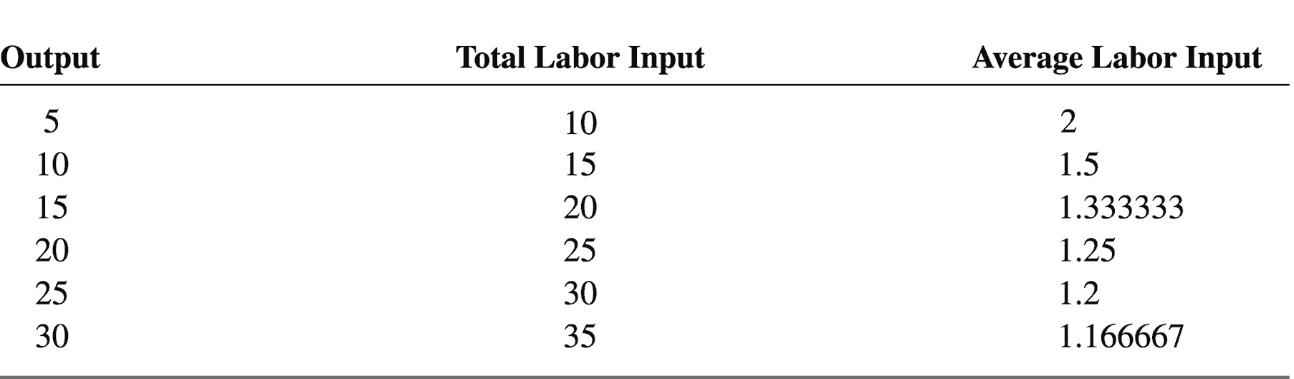
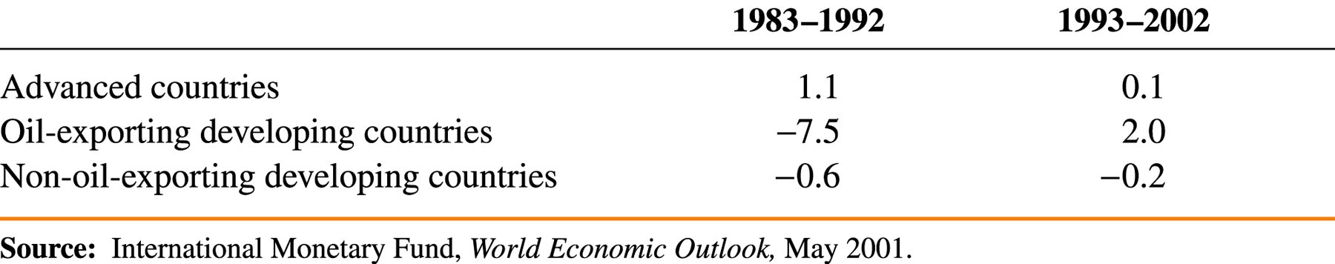
Economies of Scale and International Trade: An Overview
Table 6-1: Relationship of Input to Output for a Hypothetical Industry

Slide 7
Economies of Scale and
Market Structure
Economies of scale can be either:
  External
    The cost per unit depends on the size of the industry but not necessarily on the size of any one firm.
    An industry will typically consist of many small firms and be perfectly competitive.
    → Biaya perunit tergantung pada besarnya industri tidak tergantung pada besarnya satu perusahaan
  Internal
    The cost per unit depends on the size of an individual firm but not necessarily on that of the industry.
    The market structure will be imperfectly competitive with large firms having a cost advantage over small.
    → Biaya Per unit tergantung besarnya satu perusahaan tak perlu pada besarnya industri.
  Both types of scale economies are important causes of international trade.

Slide 8
The Theory of
Imperfect Competition
Imperfect competition
  Firms are aware that they can influence the price of their product.
    They know that they can sell more only by reducing their price.
  Each firm views itself as a price setter, choosing the price of its product, rather than a price taker.
  The simplest imperfectly competitive market structure is that of a pure monopoly, a market in which a firm faces no competition.

Slide 9
The Theory of
Imperfect Competition
Monopoly: A Brief Review
  Marginal revenue
    The extra revenue the firm gains from selling an additional unit
    Its curve, MR, always lies below the demand curve, D.
      In order to sell an additional unit of output the firm must lower the price of all units sold (not just the marginal one).

Slide 10
The Theory of
Imperfect Competition
Figure 6-1: Monopolistic Pricing and Production Decisions
Cost, C and
Price, P
Monopoly profits
PM
AC
AC
MC
D
MR
QM
Quantity, Q

Slide 11
The Theory of
Imperfect Competition
  Marginal Revenue and Price
    Marginal revenue is always less than the price.
    The relationship between marginal revenue and price depends on two things:
      How much output the firm is already selling
      The slope of the demand curve
        It tells us how much the monopolist has to cut his price to sell one more unit of output.

Slide 12
The Theory of
Imperfect Competition
    Assume that the demand curve the firm faces is a straight line:
      Q = A – B x P (6-1)
    Then the MR that the firm faces is given by:
  MR = P – Q/B (6-2)
  Average and Marginal Costs
    Average Cost (AC) is total cost divided by output.
    Marginal Cost (MC) is the amount it costs the firm to produce one extra unit.

Slide 13
The Theory of
Imperfect Competition
Monopolistic Competition
  Oligopoly
    Internal economies generate an oligopoly market structure.
      There are several firms, each of which is large enough to affect prices, but none with an uncontested monopoly.
    Strategic interactions among oligopolists have become important.
      Each firm decides its own actions, taking into account how that decision might influence its rival’s actions.

Slide 14
The Theory of
Imperfect Competition
  Monopolistic competition
    A special case of oligopoly
    Two key assumptions are made to get around the problem of interdependence:
      Each firm is assumed to be able to differentiate its product from its rivals.
      Each firm is assumed to take the prices charged by its rivals as given.

Slide 15
Monopolistic Competition and Trade
The monopolistic competition model can be used to show how trade leads to:
  A lower average price due to scale economies
  The availability of a greater variety of goods due to product differentiation
  Imports and exports within each industry (intra-industry trade)

Slide 16
Monopolistic Competition and Trade
The Effects of Increased Market Size
  The number of firms in a monopolistically competitive industry and the prices they charge are affected by the size of the market.

Slide 17
Monopolistic Competition and Trade
Figure 6-4: Effects of a Larger Market
Cost C, and
Price, P
CC1
1
CC2
P1
2
P2
PP
n1
n2
Number
of firms, n

Slide 18
Monopolistic Competition and Trade
Gains from an Integrated Market: A Numerical Example
  International trade allows creation of an integrated market that is larger than each country’s market.
    It thus becomes possible to offer consumers a greater variety of products and lower prices.

Slide 19
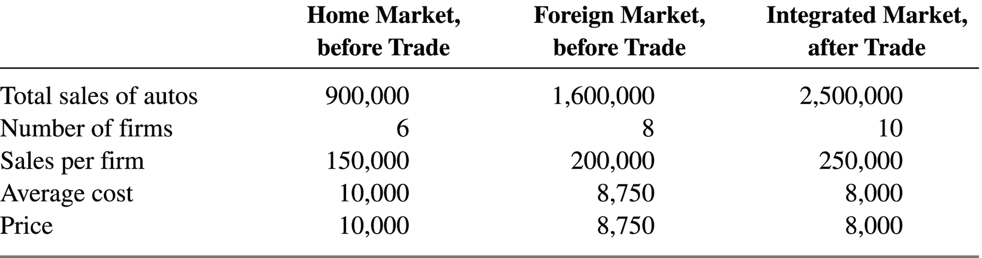
Monopolistic Competition and Trade
Table 6-2: Hypothetical Example of Gains from Market Integration

Slide 20
Monopolistic Competition and Trade
Economies of Scale and Comparative Advantage
  Assumptions:
    There are two countries: Home (the capital-abundant country) and Foreign.
    There are two industries: manufactures (the capital-intensive industry) and food.
    Neither country is able to produce the full range of manufactured products by itself due to economies of scale.

Slide 21
Monopolistic Competition and Trade
Figure 6-6: Trade in a World Without Increasing Returns
Home
(capital abundant)
Manufactures
Food
Foreign
(labor abundant)

Slide 22
Monopolistic Competition and Trade
  If manufactures is a monopolistically competitive sector, world trade consists of two parts:
    Intraindustry trade
      The exchange of manufactures for manufactures
    Interindustry trade
      The exchange of manufactures for food

Slide 23
Monopolistic Competition and Trade
Figure 6-7: Trade with Increasing Returns and Monopolistic Competition
Home
(capital abundant)
Manufactures
Food
Interindustry
trade
Intraindustry
trade
Foreign
(labor abundant)

Slide 24
Monopolistic Competition and Trade
  Main differences between interindustry and intraindustry trade:
    Interindustry trade reflects comparative advantage, whereas intraindustry trade does not.
    The pattern of intraindustry trade itself is unpredictable, whereas that of interindustry trade is determined by underlying differences between countries.
    The relative importance of intraindustry and interindustry trade depends on how similar countries are.

Slide 25
Monopolistic Competition and Trade
The Significance of Intraindustry Trade
  About one-fourth of world trade consists of intra-industry trade.
  Intra-industry trade plays a particularly large role in the trade in manufactured goods among advanced industrial nations, which accounts for most of world trade.

Slide 26
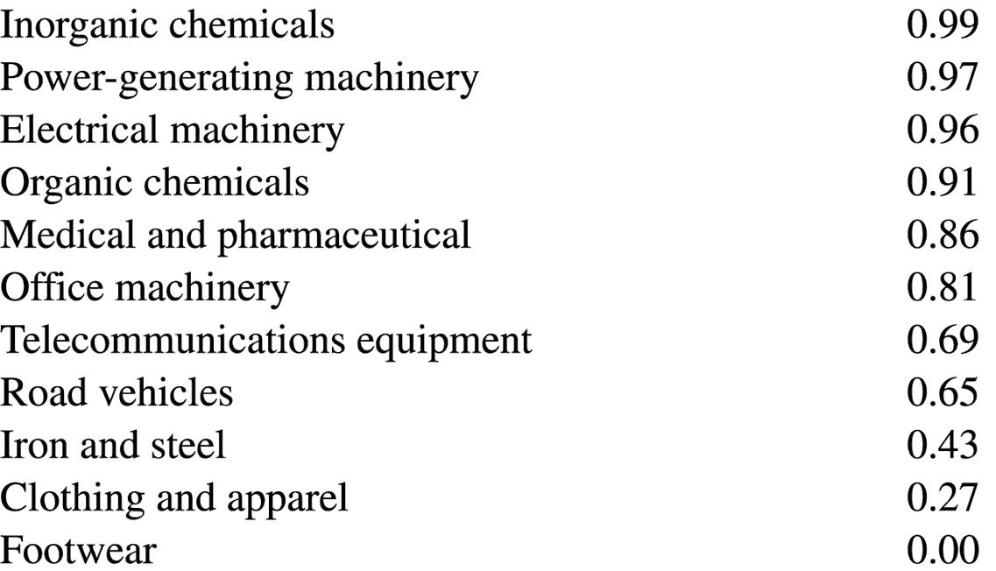
Monopolistic Competition and Trade
Table 6-3: Indexes of Intraindustry Trade for U.S. Industries, 1993

Slide 27
Monopolistic Competition and Trade
Why Intraindustry Trade Matters
  Intraindustry trade allows countries to benefit from larger markets.
    The case study of the North American Auto Pact of 1964 indicates that the gains from creating an integrated industry in two countries can be substantial.
  Gains from intraindustry trade will be large when economies of scale are strong and products are highly differentiated.
    For example, sophisticated manufactured goods.

Slide 28
Dumping
The Economics of Dumping
  Price discrimination
    The practice of charging different customers different prices
  Dumping
    The most common form of price discrimination in international trade
    A pricing practice in which a firm charges a lower price for an exported good than it does for the same good sold domestically

Slide 29
Dumping
    It is a controversial issue in trade policy and is widely regarded as an unfair practice in international trade.
      Example: As of April 2002, the United States had anti-dumping duties on 265 items from 40 different countries.
  Dumping can occur only if two conditions are met:
    Imperfectly competitive industry
    Segmented markets
  Given these conditions, a monopolistic firm may find that it is profitable to engage in dumping.

Slide 30
Dumping
Figure 6-8: Dumping
Cost, C and
Price, P
3
PDOM
MC
2
1
PFOR
DFOR = MRFOR
DDOM
MRDOM
QDOM
QMONOPOLY
Quantities produced
and demanded, Q
Domestic sales
Exports
Total output

Slide 31
Dumping
Reciprocal Dumping
  A situation in which dumping leads to two-way trade in the same product
  It increases the volume of trade in goods that are not quite identical.
  Its net welfare effect is ambiguous:
    It wastes resources in transportation.
    It creates some competition.

Slide 32
The Theory of External Economies
Economies of scale that occur at the level of the industry instead of the firm are called external economies.
There are three main reasons why a cluster of firms may be more efficient than an individual firm in isolation:
  Specialized suppliers
  Labor market pooling
  Knowledge spillovers

Slide 33
External Economies and International Trade
External Economies and the Patter of Trade
  A country that has large production in some industry will tend to have low costs of producing that good.
  Countries that start out as large producers in certain industries tend to remain large producers even if some other country could potentially produce the goods more cheaply.
    Figure 6-9 illustrates a case where a pattern of specialization established by historical accident is persistent.

Slide 34
External Economies and International Trade
Figure 6-9: External Economies and Specialization
Price, cost
(per watch)
C0
1
P1
ACSWISS
2
ACTHAI
D
Q1
Quantity of watches
produced and demanded

Slide 35
External Economies and International Trade
Trade and Welfare with External Economies
  Trade based on external economies has more ambiguous effects on national welfare than either trade based on comparative advantage or trade based on economies of scale at the level of the firm.
    An example of how a country can actually be worse off with trade than without is shown in Figure 6-10.

Slide 36
External Economies and International Trade
Figure 6-10: External Economies and Losses from Trade
Price, cost
(per watch)
C0
1
P1
ACSWISS
P2
2
ACTHAI
DWORLD
DTHAI
Quantity of watches
produced and demanded

Slide 37
Summary
Trade can result from increasing returns or economies of scale, that is, from a tendency of unit costs to be lower at larger levels of output.
Economies of scale can be internal or external.
The presence of scale economies leads to a breakdown of perfect competition.
Trade in the presence of economies of scale must be analyzed using models of imperfect competition.

Slide 38
Summary
In monopolistic competition, an industry contains a number of firms producing differentiated products.
Intraindustry trade benefits consumers through greater product variety and lower prices.
In general, trade may be divided into two kinds:
  Two-way trade in differentiated products within an industry (intraindustry trade).
  Trade in which the products of one industry are exchanged for products of another (interindustry trade).

Slide 39
Summary
Dumping occurs when a firm charges a lower price abroad than it charges domestically.
Dumping can occur only if two conditions are met:
  The industry must be imperfectly competitive.
  Markets must be geographically segmented.
External economies give an important role to history and accident in determining the pattern of international trade.
When external economies are important, countries can conceivably lose from trade.

