Slide 1
Exchange Rates and the Foreign Exchange Market:
An Asset Approach

Slide 2
Chapter Organization
Introduction
Exchange Rates and International Transactions
The Foreign Exchange Market
The Demand for Foreign Currency Assets
Equilibrium in the Foreign Exchange Market
Interest Rates, Expectations, and Equilibrium
Summary

Slide 3
Introduction
Exchange rates are important because they enable us to translate different counties’ prices into comparable terms.
Exchange rates are determined in the same way as other asset prices.
The general goal of this chapter is to show:
How exchange rates are determined
The role of exchange rates in international trade

Slide 4
Exchange Rates and International Transactions
An exchange rate can be quoted in two ways:
Direct
The price of the foreign currency in terms of dollars
Indirect
The price of dollars in terms of the foreign currency

Slide 5
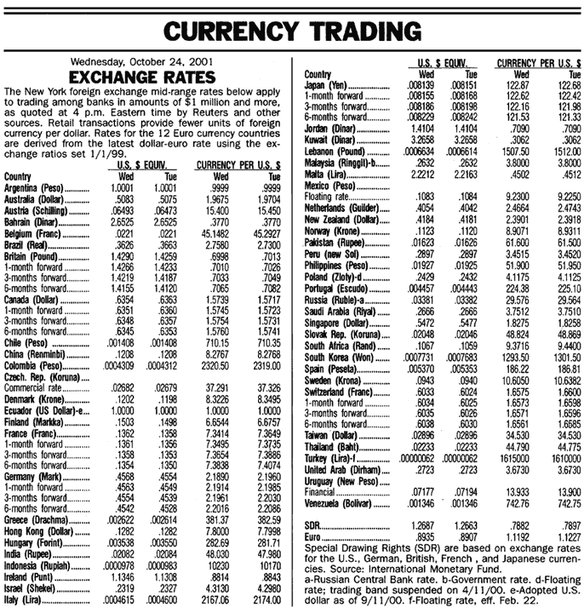
Exchange Rates and International Transactions
Table 13-1: Exchange Rate Quotations

Slide 6
Exchange Rates and International Transactions
Domestic and Foreign Prices
If we know the exchange rate between two countries’ currencies, we can compute the price of one country’s exports in terms of the other country’s money.
Example: The dollar price of a £50 sweater with a dollar exchange rate of $1.50 per pound is (1.50 $/£) x (£50) = $75.

Slide 7
Exchange Rates and International Transactions
Two types of changes in exchange rates:
Depreciation of home country’s currency
A rise in the home currency prices of a foreign currency
It makes home goods cheaper for foreigners and foreign goods more expensive for domestic residents.
Appreciation of home country’s currency
A fall in the home price of a foreign currency
It makes home goods more expensive for foreigners and foreign goods cheaper for domestic residents.

Slide 8
Exchange Rates and International Transactions
Exchange Rates and Relative Prices
Import and export demands are influenced by relative prices.
Appreciation of a country’s currency:
Raises the relative price of its exports
Lowers the relative price of its imports
Depreciation of a country’s currency:
Lowers the relative price of its exports
Raises the relative price of its imports

Slide 9
Exchange Rates and International Transactions
Table 13-2: $/£ Exchange Rates and the Relative Price of American Designer Jeans and British Sweaters

Slide 10
The Foreign Exchange Market
Exchange rates are determined in the foreign exchange market.
The market in which international currency trades take place
The Actors
The major participants in the foreign exchange market are:
Commercial banks
International corporations
Nonbank financial institutions
Central banks

Slide 11
Exchange Rates and International Transactions
Interbank trading
Foreign currency trading among banks
It accounts for most of the activity in the foreign exchange market.

Slide 12
Exchange Rates and International Transactions
Characteristics of the Market
The worldwide volume of foreign exchange trading is enormous, and it has ballooned in recent years.
New technologies, such as Internet links, are used among the major foreign exchange trading centers (London, New York, Tokyo, Frankfurt, and Singapore).
The integration of financial centers implies that there can be no significant arbitrage.
The process of buying a currency cheap and selling it dear.

Slide 13
Exchange Rates and International Transactions
Vehicle currency
A currency that is widely used to denominate international contracts made by parties who do not reside in the country that issues the vehicle currency.
Example: In 2001, around 90% of transactions between banks involved exchanges of foreign currencies for U.S. dollars.

