Slide 1
Agricultural Production and Productivity
Total production continue to increase, Productivity is increasing (output/input), we are using almost the same level of inputs if not less

Slide 2
Food Marketing Efficiency
Getting final products to consumers at lowest cost for given services
Lower spread between farm costs and retail food costs does not necessarily mean greater efficiency—intermediate functions may add value
Types of efficiency
Operational
Pricing

Slide 3
Agricultural Production and Marketing
Structure of U.S. agriculture
Dominated by small, family farms

Slide 4
Agricultural Production and Marketing
Structure of U.S. agriculture
Dominated by small, family farms
Product characteristics
Raw material
Bulkiness and perishability
Quality variation
Production characteristics
Total product
Annual variability
Seasonality

Slide 5
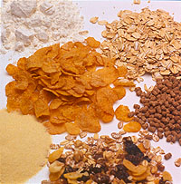
Agricultural Production and Marketing
Product characteristics
Raw material

Slide 6
Agricultural Production and Marketing
Product characteristics
Quality variation

Slide 7
Agricultural Production and Marketing
Product characteristics
Bulkiness and perishability

Slide 8
Agricultural Production characteristics
Total product
Increase due to productivity
Annual variability
Seasonality
Geographic concentration
Varying production costs
Farm supply industry (derived demand)

Slide 9
Production characteristics
Annual variability

Slide 10
Production characteristics
Seasonality

Slide 11
Production characteristics
Geographic concentration

Slide 12
Production characteristics
Varying production costs

Slide 13
Production characteristics
Farm supply industry (derived demand)

Slide 14
Marketing Problems
Lack of control over
Own output
Market supply

Slide 15
Marketing Problems
Lag in results of adjustment efforts

Slide 16
Marketing Problems
Decision of whether to engage in marketing efforts
Free rider problem

Slide 17
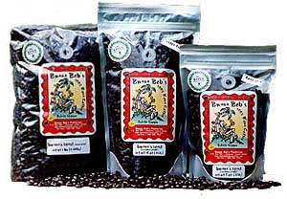
Marketing Problems
Superior bargaining power of large buyers

Slide 18
Marketing Problems
Cost squeeze

Slide 19
Some Trends
Differentiated products
Specialty/nice products
Interdependence of manufacturers and suppliers
High price risk
Science and innovation
Closed information systems
Private and proprietary research
Resource and environmental conservation
Managerial and interpersonal skills
Industrialization
Global competition
Farm incomes moving toward incomes of other sectors

