Slide 1
Agricultural Marketing
Agricultural Marketing is an integrated process of moving agricultural products from farms to consumers.
Numerous interconnected activities are involved in doing this, such as planning production, growing and harvesting, grading, packing, transport, storage, agro- and food processing, distribution, and sale.
Such activities cannot take place without the exchange of information and are often heavily dependent on the availability of suitable finance.
Marketing systems are dynamic; they are competitive and involve continuous change and improvement.

Slide 2
Agricultural Marketing
Every person in the world is affected, on a daily basis, by the way agricultural markets provide alternative quantities and qualities of various food for consumption.
The efficiency with which all of these activities occur affects prices that consumers pay for the food they purchase as well as the prices that farmers receive for their products.
Less than 2% of the US population reside on farms and obtain income directly from producing agricultural products.
A much larger fraction of the US population depends on marketing of agricultural products as a major source of income.

Slide 3
Consumer Food
Expenditure
Marketing Bill
100%
82%
=
Farm
Value
+
18%
Source: USDA, 2008

Slide 4
Views of Ag. Marketing
The MACRO view
Macro marketing is the performance of all business activities involved in the forward flow of goods and services from the producer to the consumer.
The WHO and WHAT of Marketing
The MICRO View
Micro marketing is the performance of business activities that direct the flow of goods and services to the customer and accomplish the objective of the firm.
The HOW and WHY of Marketing

Slide 5
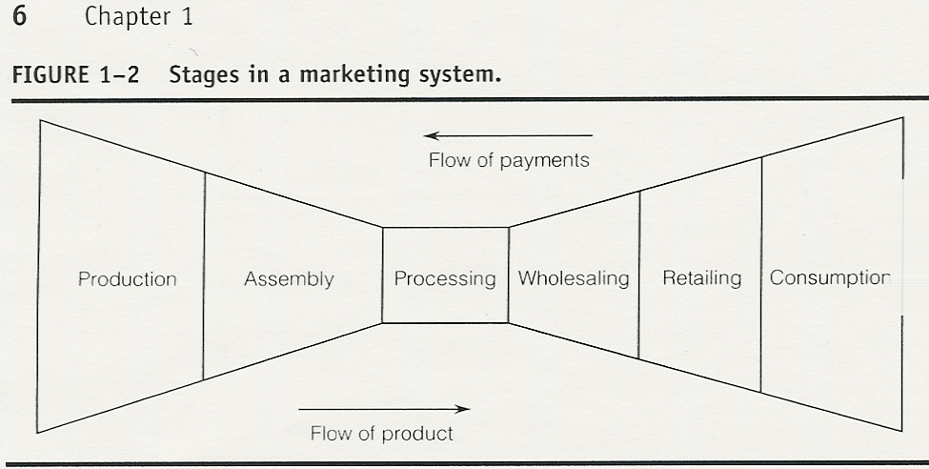

Slide 6
Macro view: Three approaches to the study of marketing agricultural products
Institutional Approach: Emphasizes the “Who” of marketing
Middlemen – assemblers, wholesalers, brokers, retailers, order buyers, information providers, etc.
Functional Approach: Emphasizes the “What” of marketing
Functions that are performed in agricultural marketing –
exchange functions, physical functions and facilitating functions
3. Behavioral Approach: Emphasizes the interdependence and
coordination of all participants and all the functions of the
entire system – combines institutional and functional approaches

Slide 7
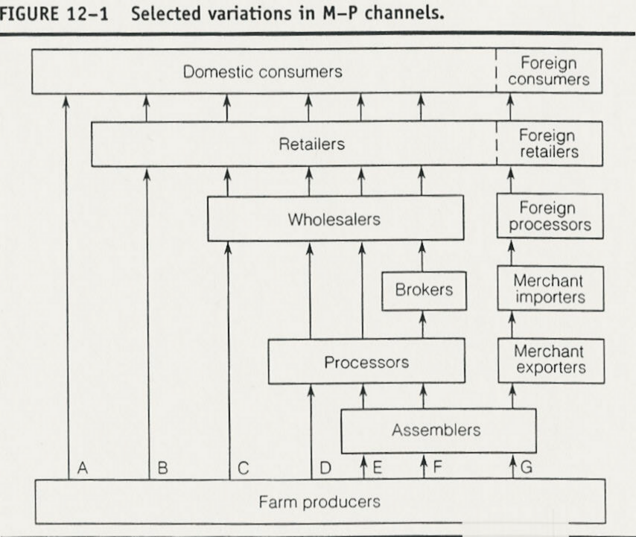

Slide 8
Uses of the Institutional Approach
help to look at specialization due to efficiencies such as:
division of labor and specialization
economies of scale and size
reduced market search and transaction costs due to middlemen

Slide 9
Functions in Agricultural Markets—one way to analyze
Selling
Storage
Transportation
Processing
Facilitating
Standardization
Financing
Risk bearing
Market Intelligence

Slide 10
Selling to
Processors
For final products (e.g., flour)
For manufacturing of ingredients
Intermediaries
Wholesalers
Retailers
Customers
Consumers
Institutions

Slide 11
Storage
Storage
Seasonal
Timing of production vs. cost of storage
Feasibility of timing market (turkeys vs. wheat)
Queuing

Slide 12
Transportation
Cost vs. speed
Perishability
Value of freshness to customers
Ability to predict demand
Need for bulk reduction (see processing)

Slide 13
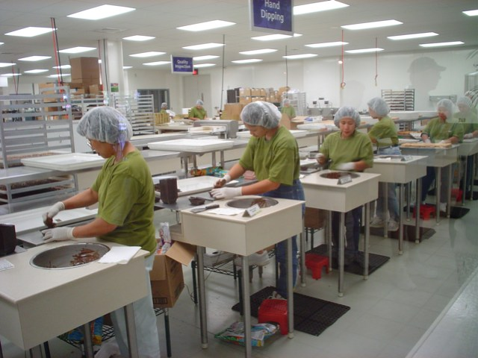
Processing
Treatment of product (e.g., wheat to flour)
Reduction of bulk (oranges to concentrate—not orange juice yet)
Creation of labor saving food products (e.g., frozen pizza)

Slide 14
Facilitating
Farmers’ agents
Matching demand and supply
Other information search—e.g., demand forecast
Negotiations
Logistics handling

Slide 15
Standardization
Agricultural grades and labeling
Food branding

Slide 16
Financing
Long term lending
Farm mortgages
Equipment loans
Short term lending
Advances against harvests
Financing of store and processor inventory
Futures contracts

Slide 17
Risk Bearing
Futures contracts
Investments in new food products (most will fail)
Evaluation of credit worthiness of farmers and other parties

Slide 18
Market Intelligence
Market research
Forecasting
Demand
For existing products
Spread of new products
Supply

Slide 19
Behavioral Systems
Input-output
Different parties provide goods and services moving toward final products
Communications
Matching supply and demand
Adaptation to outside changes—e.g.,
Consumer tastes
World supply

Slide 20
Micro Marketing
From a micro, firm manager perspective, the customer is the next stage in the marketing system.
What does this mean?
The firm manager will play an active role in overseeing the firm’s marketing decisions that include:
Procurements and merchandising (buying and selling)
Identify consumer preference and product choice
Product design and development, processing, and packaging
Pricing
Promotion
Storage and transportation

Slide 21
Consumer Sovereignty
The economic doctrine that the consumer is Queen or King in the marketplace that is driven by consumer demand is known as Consumer Sovereignty.
This is the concept that each consumer decides independently what to buy and that the combined individual decisions directs all production and marketing activities in the economy.
But consumer demand is influenced by effective
Advertising and Promotions

