Slide 1
Efficiency
Consumer, Producer and Markets

Slide 2
Efficiency Defined
Overall: Greatest human satisfaction from scarce resources.
Allocative Efficiency – resources are dedicated to the combination of goods and services that best satisfy consumer wants
Production Efficiency – goods and services are produced using the least cost combination of resources and technology
Dynamic Efficiency – how the economy over time promotes allocative and productive efficiency

Slide 3
Efficiency: Positive versus Normative Perspectives
Positive – an objective analysis of how economic variables are related
Normative – a prescriptive analysis to help determine what ought to be.
Welfare economics – the study of how the allocation of resources affects economic well-being.

Slide 4
Measuring Economic Welfare: Consumer Surplus
So far, we have demonstrated that people maximize total net benefits from an activity at the point where MB=MC
Marginal benefits are equal to the (max.) willingness to pay and decline as quantity demanded increase because of the law of diminishing marginal utility (jelly bean example).
Since consumer as price takers in competitive markets, the price equals the marginal costs to consumers.
Consumer surplus equals willingness to pay minus the price, which is the same as net benefits we have discussed before.

Slide 5
Using the demand curve to measure consumer surplus
Before: giving a price and finding the corresponding quantity demanded
Now: giving the quantity and finding the amount people are willing to pay for a good or go without it
MB=MC occurs where price intersects the demand curve and total net benefits=consumer surplus is maximized. Cool, no!

Slide 6

Figure 2 Measuring Consumer Surplus with the Demand Curve
(a) Price = $80
Price of
Album
$100
John
’
s consumer surplus ($20)
80
70
50
Demand
0
1
2
3
4
Quantity of
Albums
Copyright©2003 Southwestern/Thomson Learning

Slide 7
Figure 2 Measuring Consumer Surplus with the Demand Curve
(b) Price = $70
Price of
Album
$100
John
’
s consumer surplus ($30)
80
Paul
’
s consumer
70
surplus ($10)
Total
50
consumer
surplus ($40)
Demand
0
1
2
3
4
Quantity of
Albums
Copyright©2003 Southwestern/Thomson Learning

Slide 8
Figure 3 How the Price Affects Consumer Surplus
(a) Consumer Surplus at Price
P
Price
A
Consumer
surplus
P₁
B
C
Demand
0
Q₁
Quantity
Copyright©2003 Southwestern/Thomson Learning

Slide 9
Figure 3 How the Price Affects Consumer Surplus
(b) Consumer Surplus at Price
P
Price
A
Initial
consumer
surplus
P₁
C
Consumer surplus
B
to new consumers
P₂
F
D
E
Additional consumer
Demand
surplus to initial
consumers
0
Q₁
Q₂
Quantity
Copyright©2003 Southwestern/Thomson Learning

Slide 10
Producer Surplus
Consumer surplus measures the difference between the (max.) willingness to pay and the price.
Producer surplus measure the difference between the (min.) needed to be willing to sell and the price.

Slide 11
Remember, the Law of Diminishing Marginal Returns causes marginal costs to rise in the short-run as output increases.
  As more the the variable input is added to the fixed input, its marginal product eventually begins to diminish (production exercise in class).
  If all workers are paid the same wage, the LDMR implies that the extra (marginal) costs of producing extra (marginal) outputs increases.

Slide 12
If the seller is a price taker, they receive the same price for very output sold. So the difference between the price and the marginal cost (the willingness to sell) is the:
  Producer Surplus

Slide 13
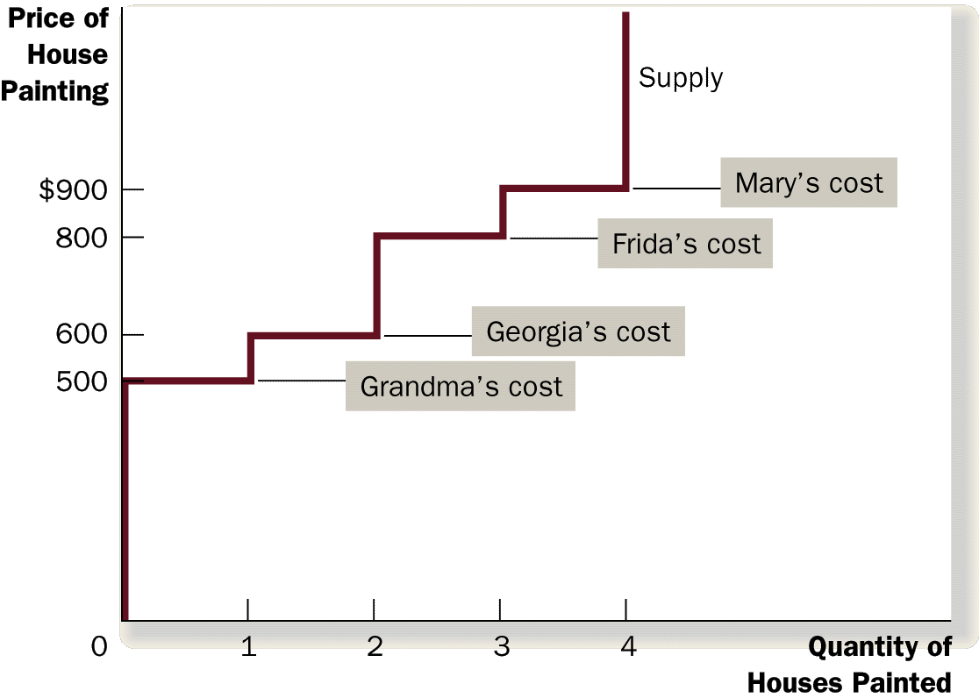
Figure 4 The Supply Schedule and the Supply Curve

Slide 14
Figure 5 Measuring Producer Surplus with the Supply Curve
(a) Price = $600
Price of
House
Painting
Supply
$900
800
600
500
Grandma
’
s producer
surplus ($100)
0
1
2
3
4
Quantity of
Houses Painted
Copyright©2003 Southwestern/Thomson Learning

Slide 15
Figure 5 Measuring Producer Surplus with the Supply Curve
(b) Price = $800
Price of
House
Painting
Supply
Total
producer
$900
surplus ($500)
800
600
Georgia
’
s producer
500
surplus ($200)
Grandma
’
s producer
surplus ($300)
0
1
2
3
4
Quantity of
Houses Painted
Copyright©2003 Southwestern/Thomson Learning

Slide 16
Figure 6 How the Price Affects Producer Surplus
(a) Producer Surplus at Price
P
Price
Supply
P₁
B
C
Producer
surplus
A
0
Q₁
Quantity
Copyright©2003 Southwestern/Thomson Learning

Slide 17
Figure 6 How the Price Affects Producer Surplus
(b) Producer Surplus at Price
P
Price
Additional producer
Supply
surplus to initial
producers
D
E
P₂
F
P₁
B
Initial
C
Producer surplus
producer
to new producers
surplus
A
0
Q₁
Q₂
Quantity
Copyright©2003 Southwestern/Thomson Learning

Slide 18
Competitive Markets and Efficiency
Assume competitive markets (many buyers and sellers, identical products, free entry and exit, price takers, etc.)
Assume that consumer surplus measures consumers economic well-being and producer surplus that of sellers.
So, MB = willingness to pay by consumers and MC = willingness to sell to producers

Slide 19
MB=MC
Occurs where the demand and supply curve intersect, and
Total Well-being is Maximized

Slide 20
Figure 7 Consumer and Producer Surplus in the Market Equilibrium
Price
A
D
Supply
Consumer
surplus
Equilibrium
E
price
Producer
surplus
Demand
B
C
0
Equilibrium
Quantity
quantity
Copyright©2003 Southwestern/Thomson Learning

Slide 21
Figure 8 The Efficiency of the Equilibrium Quantity
Price
Supply
Value
Cost
to
to
buyers
sellers
Cost
Value
to
to
sellers
buyers
Demand
0
Equilibrium
Quantity
quantity
Value to buyers is greater
Value to buyers is less
than cost to sellers.
than cost to sellers.
Copyright©2003 Southwestern/Thomson Learning

