Slide 1
Demand and Supply

Slide 2
Theories and Predictions
We need to be able to predict the consequences of
  alternative policies, and
  events that may be outside our control
The mental tool we use to make such predictions is called a theory
A theory is of no use if its predictions are inaccurate

Slide 3
We need a theory of prices
The theory of demand and supply is a simple example of an economic theory
It can be used to make predictions about the price and quantity of some commodity
In a free-market economy, most economic decisions are guided by prices
Therefore, without a reliable theory of prices, you will get nowhere in economic analysis

Slide 4
Assume perfect competition
The theory of supply and demand assumes that commodities are traded in perfectly competitive markets
A perfectly competitive market is a market in which
  there are many buyers
  many sellers
  and all sellers sell the exact same product
As a result, each buyer and seller has a negligible impact on the market price

Slide 5
demand

Slide 6
Demand
Quantity demanded is the amount of a good that buyers are willing and able to purchase
Demand is a full description of how the quantity demanded changes as the price of the good changes.

Slide 7
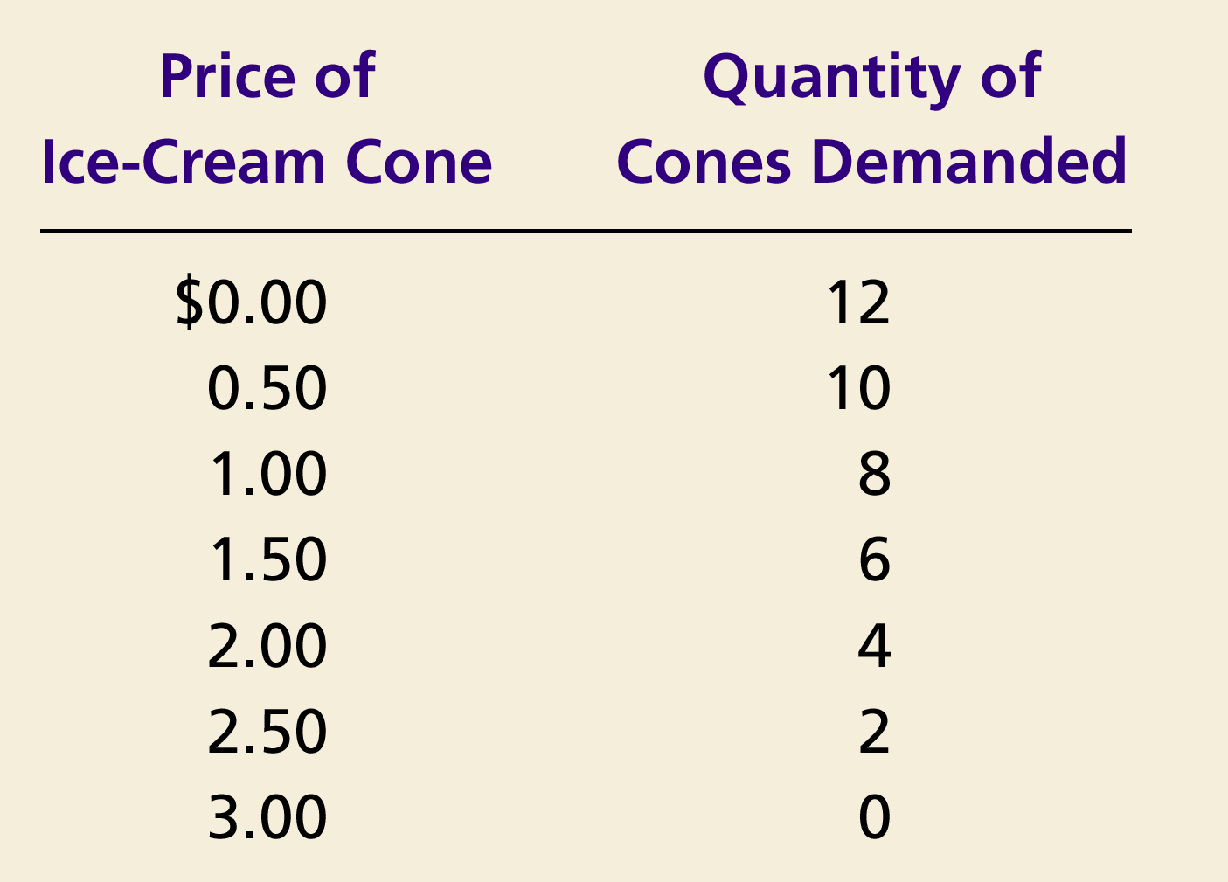
Catherine’s Demand Schedule and Demand Curve
Price of
Ice-Cream Cone
$3.00
2.50
1. A decrease
2.00
in price
...
1.50
1.00
0.50
0
1
2
3
4
5
6
7
8
9
10
11
12
Quantity of
Ice-Cream Cones
2.
...
increases quantity
of cones demanded.
Copyright © 2004 South-Western

Slide 8
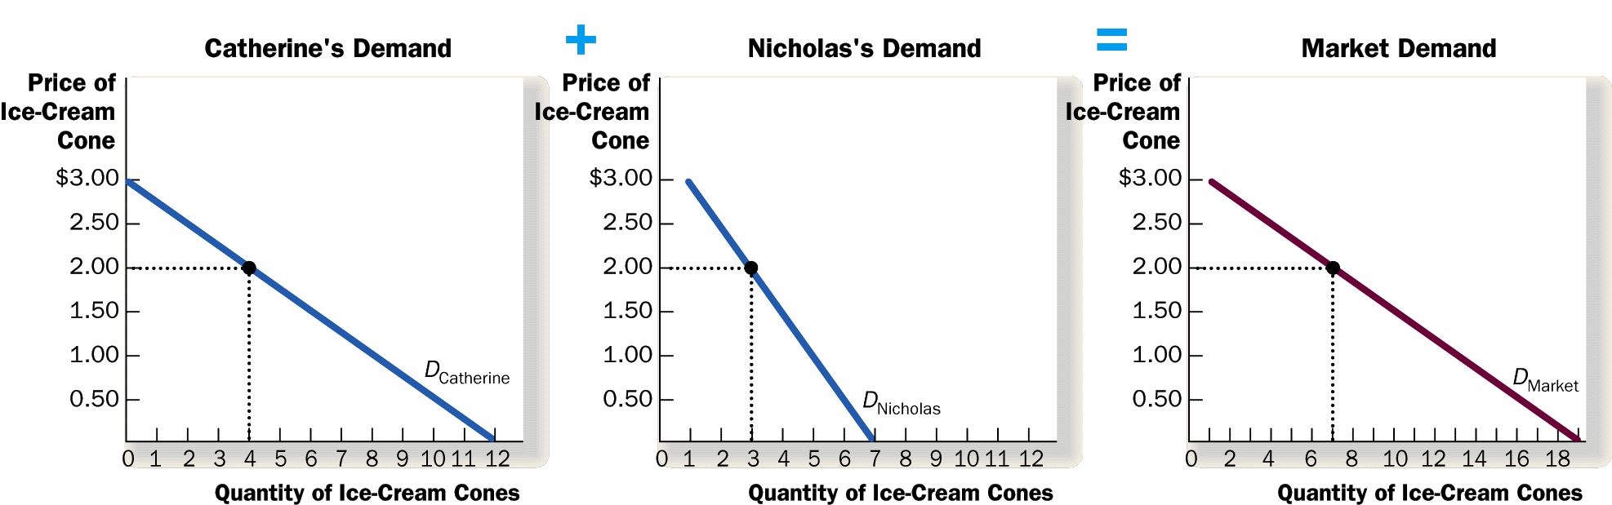
Market Demand is the Sum of Individual Demands

Slide 9
Law of Demand
The law of demand states that
  the quantity demanded of a good falls when the price of the good rises, and vice versa, provided all other factors that affect buyers’ decisions are unchanged

Slide 10
“provided all other factors … are unchanged”
That’s an important phrase in the wording of the Law of Demand
The quantity demanded of a consumer good such as ice cream depends on
  The price of ice cream
  The prices of related goods
  Consumers’ incomes
  Consumers’ tastes
  Consumers’ expectations about future prices and incomes
  Number of buyers, etc
The Law of Demand says that the quantity demanded of a good is inversely related to its price, provided all other factors are unchanged

Slide 11
Why Might Demand Increase?
 | Quantity Demanded
Price | Situation A | Situation B
0.00 | 12 | 20
0.50 | 10 | 16
1.00 | 8 | 12
1.50 | 6 | 8
2.00 | 4 | 6
2.50 | 2 | 4
3.00 | 0 | 2
How can we explain the difference in Catherine’s behavior in situations A and B?
Why does she consume more in situation B at every possible price?
Price
Quantity Demanded

Slide 12
Changes in Demand
Change in the quantity demanded due to a price change occurs ALONG the demand curve
An increase in the Price of Widgets from $3 to $4 will lead to a decrease in the Quantity Demanded of Widgets from 6 to 4.

Slide 13
Shifts in the Market Demand Curve
… are caused by changes in:
  Consumer income
  Prices of related goods
  Tastes
  Expectations, say, about future prices and prospects
  Number of buyers
Notes:
11

Slide 14
Shifts in the Demand Curve
Price of
Ice-Cream
Cone
Increase
in demand
Decrease
in demand
Demand
curve,
D
2
Demand
curve,
D
1
Demand curve,
D
3
0
Quantity of
Ice-Cream Cones

Slide 15
Changes in Demand
Several factors will change the demand for the good (shift the entire demand curve)
As an example, suppose consumer income increases. The demand for Widgets at all prices will increase.

Slide 16
Changes in Demand
Demand will also decrease due to changes in factors other than price.
As an example, suppose Widgets become less popular to own.

Slide 17
Shifts in the Demand Curve
Consumer Income
  As income increases the demand for a normal good will increase
  As income increases the demand for an inferior good will decrease
Prices of Related Goods
  When a fall in the price of one good reduces the demand for another good, the two goods are called substitutes
  for example: coke price ; Pepsi demand
  When a fall in the price of one good increases the demand for another good, the two goods are called complements
  for example: peanut butter ; Jam demand

Slide 18
The Law of Demand—Explanations
There are two ways to explain the Law of Demand
  Substitution effect
  Income effect

Slide 19
Substitution Effect
When the price of a good decreases, consumers substitute that good instead of other competing (substitute) goods
1. When the price of Coke decreases…
2. Consumption of Pepsi decreases…
3. Consumption of Coke increases
Clothes
Coke
Books
Movies
Pepsi

Slide 20
Income Effect
A decrease in the price of a commodity is essentially equivalent to an increase in consumers’ income

Slide 21
Lower Prices = Higher Income
Situation A
Price of an Apple | $1.00
Price of an Orange | $2.00
Income | $10.00
If income rises, Situation A becomes Situation B.
Situation B
Price of an Apple | $1.00
Price of an Orange | $2.00
Income | $20.00
If prices fall, Situation A becomes Situation C.
Situation C
Price of an Apple | $0.50
Price of an Orange | $1.00
Income | $10.00
Q: Which change is better?
A: They are both equally desirable. A fall in prices is equivalent to an increase in income.

Slide 22
Income Effect
Consumers respond to a decrease in the price of a commodity as they would to an increase in income
They increase their consumption of a wide range of goods, including the good that had a price decrease
1. When the price of Coke decreases…
2. Consumers feel richer…
3. Consumption of Coke and other goods increases
Clothes
Coke
Books
Movies
Pepsi

Slide 23
supply

Slide 24
SUPPLY
Quantity supplied is the amount of a good that sellers are willing and able to sell
Supply is a full description of how the quantity supplied of a commodity responds to changes in its price
Notes:
25

Slide 25
Ben’s supply schedule and supply curve
Price of
Ice-Cream
Cones
Supply curve
$3.00
Price of Ice-cream cone | Quantity of Cones supplied
$0.00 0.50 1.00 1.50 2.00 2.50 3.00 | 0 cones 0 1 2 3 4 5
2.50
1. An increase
in price . . .
2.00
1.50
2. . . . increases quantity
of cones supplied.
1.00
0.50
0
1
2
3
4
5
6
7
8
9
10
11
12
Quantity of Ice-Cream Cones

Slide 26
Market supply and individual supplies
Price of ice-cream cone | Ben |  | Jerry |  | Market
$0.00 0.50 1.00 1.50 2.00 2.50 3.00 | 0 0 1 2 3 4 5 | + | 0 0 0 2 4 6 8 | = | 0 0 1 4 7 10 13

Slide 27
Market supply and individual supplies
Ben’s
supply
+
Jerry’s
supply
=
Market
supply
Price of
Ice
Cream
Cones
Price of
Ice
Cream
Cones
Price of
Ice
Cream
Cones
S_{Ben}
$3.00
$3.00
$3.00
S_{Market}
S_{Jerry}
2.50
2.50
2.50
2.00
2.00
2.00
1.50
1.50
1.50
1.00
1.00
1.00
0.50
0.50
0.50
0
1
2
3
4
5
6
7
8
9
10
11
12
0
1
2
3
4
5
6
7
0
2
4
6
8
10
12
14
16
18
Quantity of Ice-Cream Cones
Quantity of
Ice-Cream Cones
Quantity of Ice-Cream Cones

Slide 28
Law of Supply
The law of supply states that, the quantity supplied of a good rises when the price of the good rises, as long as all other factors that affect suppliers’ decisions are unchanged

Slide 29


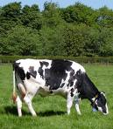

Introduction to Supply
The reason the supply curve slopes upward is due to costs and profit.
Producers purchase resources and use them to produce output.
  Producers will incur costs as they bid resources away from their alternative uses.

Slide 30
Introduction to Supply
Businesses provide goods and services hoping to make a profit.
  Profit is the money a business has left over after it covers its costs.
  Businesses try to sell at prices high enough to cover their costs with some profit left over.
  The higher the price for a good, the more profit a business will make after paying the cost for resources.

Slide 31
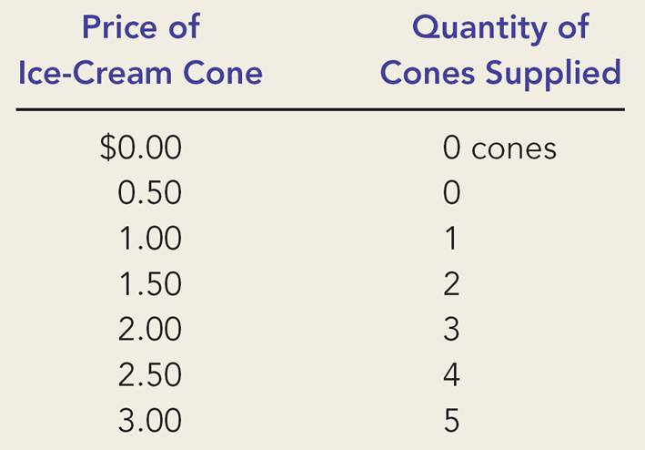
Law of Supply—Explanation
How can we make sense of the numbers in Ben’s supply schedule?
The best guess is that his costs must be something like the cost schedule below.
A specific ice-cream cone | It’s cost ($)
1st | 0.75
2nd | 1.35
3rd | 1.75
4th | 2.30
5th | 2.85
6th | 3.10
In this way, the Law of Supply follows from the assumption of Increasing Costs (or, Diminishing Returns)

Slide 32
Shifts in the Supply Curve: What causes them?
Price of
Ice-Cream
Supply curve,
S
3
Supply
Cone
curve,
S
1
Supply
Decrease
curve,
S
2
in supply
Increase
in supply
0
Quantity of
Ice-Cream Cones

Slide 33
Supply Shift
How could Ben’s supply have increased?
Ben’s Supply Schedule
Price ($) | Quantity Supplied
 | Before | After
0.00 | 0 | 0
0.50 | 0 | 1
1.00 | 1 | 2
1.50 | 2 | 3
2.00 | 3 | 4
2.50 | 4 | 5
3.00 | 5 | 6
Ice-cream cone | It’s cost ($)
 | Before | After
1st | 0.75 | 0.45
2nd | 1.35 | 0.85
3rd | 1.75 | 1.45
4th | 2.30 | 1.95
5th | 2.85 | 2.45
6th | 3.10 | 2.90
Anything that reduces production costs, shifts supply to the right.

Slide 34
Changes in Supply
Supply Curves can also shift in response to the following factors:
  Subsidies and taxes: government subsides encourage production, while taxes discourage production
  Technology: improvements in production increase ability of firms to supply
  Other goods: businesses consider the price of goods they could be producing
  Number of sellers: how many firms are in the market
  Expectations: businesses consider future prices and economic conditions
  Resource costs: cost to purchase factors of production will influence business decisions
STONER: factors that shift the supply curve

Slide 35
Changes in Supply
Several factors will change the demand for the good (shift the entire demand curve)
As an example, suppose that there is an improvement in the technology used to produce widgets.

Slide 36
Changes in Supply
Supply can also decrease due to factors other than a change in price.
As an example, suppose that a large number of Widget producers go out of business, decreasing the number of suppliers.

Slide 37
 | Cost to Produce | Amount of Supply | Supply Curve Shifts
Cost of Resources Falls
Cost of Resources Rises
Productivity Decreases
Productivity Increases
New Technology
Higher Taxes
Lower Taxes
Government Pays Subsidy

Slide 38
equilibrium

Slide 39
Interaction of demand and supply
We have seen what demand and supply are
We have seen why demand and supply may shift
Now it is time to say something about how buyers and sellers collectively determine the market outcome
To do this, we assume equilibrium

Slide 40
Equilibrium
We assume that the price will automatically reach a level at which the quantity demanded equals the quantity supplied

Slide 41
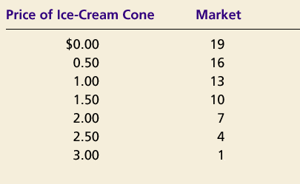
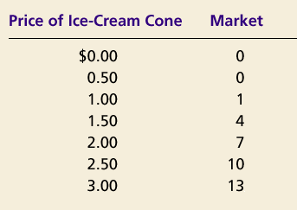
SUPPLY AND DEMAND TOGETHER
Demand Schedule
Supply Schedule
At $2.00, the quantity demanded is equal to the quantity supplied!
Notes:
36

Slide 42
Equilibrium of supply and demand
Price of
Ice-Cream
Cones
Supply
$3.00
2.50
Equilibrium
price
Equilibrium
2.00
1.50
1.00
Equilibrium
quantity
Demand
0.50
0
1
2
3
4
5
6
7
8
9
10
11
12
Quantity of Ice-Cream Cones

Slide 43
Markets Not in Equilibrium
(a) Excess Supply
Price of
Ice-Cream
Supply
Cone
Surplus
$2.50
2.00
Demand
0
4
7
10
Quantity of
Quantity
Quantity
Ice-Cream
demanded
supplied
Cones

Slide 44
Markets Not in Equilibrium
Surplus
  When price exceeds equilibrium price, then quantity supplied is greater than quantity demanded
    There is excess supply or a surplus
    Suppliers will lower the price to increase sales, thereby moving toward equilibrium

Slide 45
Markets Not in Equilibrium
(b) Excess Demand
Price of
Ice-Cream
Supply
Cone
$2.00
1.50
Shortage
Demand
0
4
7
10
Quantity of
Quantity
Quantity
Ice-Cream
supplied
demanded
Cones

Slide 46
Markets Not in Equilibrium
Shortage
  When price is less than equilibrium price, then quantity demanded exceeds the quantity supplied
    There is excess demand or a shortage
    Suppliers will raise the price due to too many buyers chasing too few goods, thereby moving toward equilibrium

Slide 47
Equilibrium
Law of supply and demand
  The price of any good adjusts to bring the quantity supplied and the quantity demanded for that good into balance

Slide 48
Supply and Demand at Work
When operating without restriction, our market economy eliminates shortages and surpluses.
  Over time, a surplus forces the price down and a shortage forces the price up until supply and demand are balanced.
  The point where they achieve balance is the equilibrium price. At this price, neither a surplus nor a shortage exists.
Once the market price reaches equilibrium, it tends to stay there until either supply or demand changes.
  When that happens, a temporary surplus or shortage occurs until the price adjusts to reach a new equilibrium price.

Slide 49
Let’s make some predictions
We can use our understanding of the factors that shift the demand and supply curves to predict the consequences of
  Alternative policy proposals, and
  Events outside our control

Slide 50
How an Increase in Demand Affects the Equilibrium
Price of
Ice-Cream
1. Hot weather increases
Cone
the demand for ice cream . . .
Supply
$2.50
New equilibrium
2.00
2. . . . resulting
Initial
in a higher
equilibrium
price . . .
D
D
0
7
10
Quantity of
3.
. . .
and a higher
Ice-Cream Cones
quantity sold.

Slide 51
How a Decrease in Supply Affects the Equilibrium
Price of
Ice-Cream
1. An increase in the
Cone
price of sugar reduces
S₂
the supply of ice cream. . .
S₁
New
$2.50
equilibrium
2.00
Initial equilibrium
2. . . . resulting
in a higher
price of ice
cream . . .
Demand
0
4
7
Quantity of
3.
. . .
and a lower
Ice-Cream Cones
quantity sold.

Slide 52
A Shift in Both Supply and Demand
Event | Effect on Price | Effect on Quantity
Demand increases | Up | Up
Supply decreases | Up | Down
Both | Up | Ambiguous

Slide 53
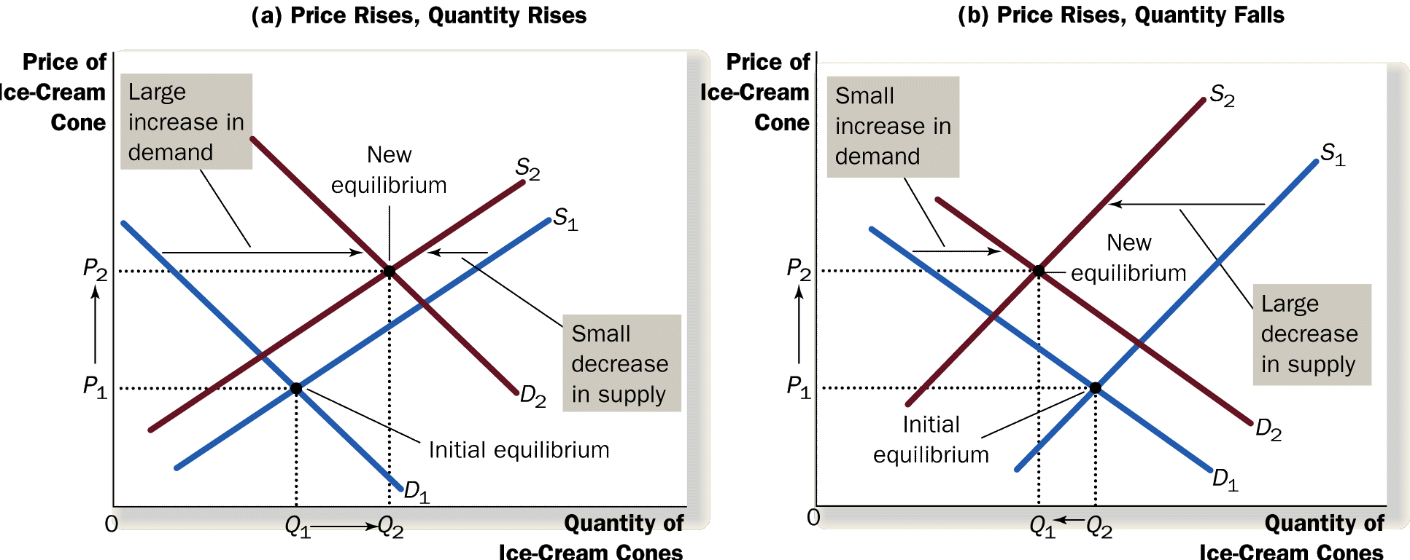
A Shift in Both Supply and Demand

Slide 54
Prediction exercises
Effect of a rise in the price of oil on the market for
  Hybrid cars
  Real estate
  Staple foods (corn, wheat, rice)
Effect of the development of cheaper and better batteries for electric cars on the market for
  traditional cars
  gas

