Slide 1
Minggu ke 3
Keamanan dan sanitasi hasil ternak
Yuli Yanti, S.Pt., M.Si
yuli_mf@yahoo.com
yyanti12.staff.uns.ac.id
LAB. IPHT FP-UNS

Slide 2
Sanitasi
Clean—free of visible soil
Sanitize—reduce the number of bacteria to a safe level
Sterilize—to make free of bacteria
Contamination—the presence of harmful substances in food
Bahasa Yunani: Sanitas → Health
Dalam bidang industri pangan → sanitation means creating and maintaining hygienic and healthful conditions

Slide 3
Cleaning vs. Sanitizing
Cleaning
  Free of visible soil, dirt, dust or food waste
Sanitizing
  Process of reducing the number of microorganisms, bacteria on a clean surface to safe levels
  Some type of cleaning solution

Slide 4
WHY SANITATION ?
Masih banyak kasus keracunan makanan di laporkan
Masih banyak kasus diare yang berujung kematian
dll

Slide 5

FOOD SAFETY & SANITATION
This is what happens when a fly lands on your food.
Flies can not eat solid food, so to soften it up they vomit on it. Then they stamp the vomit until it’s a liquid. When its good and runny, they suck it all back again, probably dropping some excrement at the same time.

Slide 6
WATER SUPPLY AND SANITATION COVERAGE 2000
% TOTAL WATER SUPPLY % TOTAL SANITATION
India 88% 31%
Bangladesh 97% 53%
Indonesia 76% 66%
Thailand 80% 96%
Myanmar 68% 46%

Slide 8

Importance of Food Safety & Sanitation
Lack of proper food safety & sanitation can cause:
  Loss of customers & sales
  Loss of prestige & reputation
  Lawsuits – resulting in court fees
  Increased insurance premiums
  Lowered employee morale / absenteeism
  Need for retraining

Slide 9
FOOD SANITATION:
FOOD BORNE DISEASES

Slide 10
FOOD SANITATION:
FOOD BORNE DISASE

Slide 11
MILK SANITATION
STERILIZATION- The application of high temperature for the purpose of destroying all types of microorganisms.
PASTEURIZATION- The application of heat to milk for the purpose of destroying pathogenic microorganisms with minimum injury to the substance

Slide 12

MILK SANITATION
TYPES OF PASTEURIZATION:
  HOLDING OR VAT PASTEURIZATION: 142—143 F FOR 30 MINS.
  HIGH TEMPERATURE, SHORT TIME [HTST]- 160-162 F FOR 15 MINS.
  FLASH PASTEURIZATION- 190 F FOR FEW SECONDS.

Slide 13
Cross-Contamination
Definition: The spread of harmful germs from one surface to another, or to food
Can be prevented by
  proper sanitary practices
  Proper Hand washing
  Using clean utensils
  Sanitizing between tasks
  Isolation of workstations is important when preparing potentially hazardous food

Slide 14
Food Hazards
Biological Hazards - Danger to food safety caused by disease-causing micro-organisms
Chemical Hazards – Danger to food safety caused by cleaners, pesticides and other chemicals
Physical Hazards – Danger to food safety caused by glass, metal & other physical particles

Slide 15
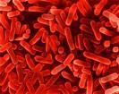
Bacteria
Can multiply rapidly to disease-causing levels at favorable temps
Can produce toxins in food that can poison humans when the food is eaten
Cause most food borne illnesses

Slide 16

Viruses
Do not grow in food, but can be transported by food items.
Transported by many food items, including ice & water.

Slide 17
Parasites
Live inside a host to survive
Can cause people to become infected if they eat raw or undercooked meat.

Slide 18


Fungi
Molds: Cause illnesses, infections, and allergies
Yeast: spoils food

Slide 19
Factors that Contribute to a Sanitary Facility
Facility design
Equipment design
Good cleaning and sanitizing procedures
Good written sanitation programs and monitoring procedures
Notes:
19

Slide 20
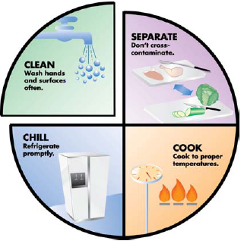
Clean: Wash hand and surfaces often
Separate: Don’t cross-contaminate
Cook: Cook to proper temperatures
Chill: Refrigerate promptly

Slide 21
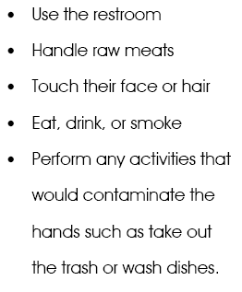
Hand washing
After---------------------→

Slide 22
FOOD AND MILK SANITATION
The GOLDEN RULE of food sanitation is:
“Keep it cold or hot, and keep it covered”

Slide 23
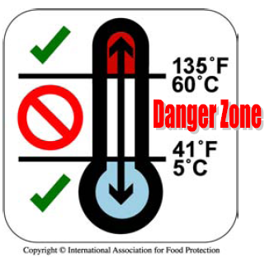
Danger Zone

Slide 24
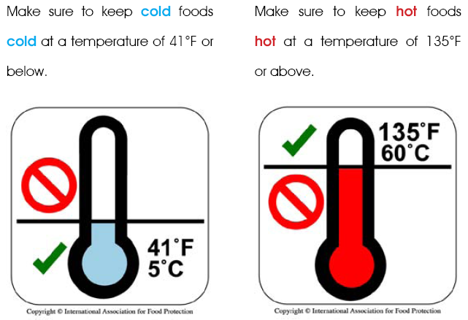

Slide 25
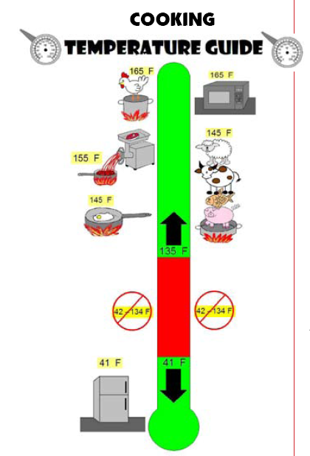
Cooking temperature guide

